Slide 1
Vaccinated susceptibles are able to get infected
Parameter | Description
r_{x} | Rate of Vaccination in subpopulation x
β_{xy} | Per capita rate of transmission from infectious subpopulation y to susceptible subpopulation x
γ | Per capita rate of recovery
σ₁ | Per capita rate of immunity loss (vaccinated individuals)
σ₂ | Per capita rate of immunity loss (from natural infection)
σ₃ | Per capita rate of immunity loss (for those who have been infected/recovered and vaccinated)
e_{ff1} | Vaccine Efficacy (preventing infection)
e_{ff2} | Vaccine Efficacy (preventing onwards infectiousness)
V_{i}
β_{xx}
Vi_{i}
γ
Vr_{i}
σ₃
σ₁
r_{i} · (S_{i} /(S_{i}+I_{i}+R_{i}))
β_{xx}
S_{i}
I_{i}
γ
R_{i}
Example sub-population i
σ₂
r_{i} · (I_{i}/(S_{i}+I_{i}+R_{i}))
Compartment | Description (Proportion of population in…)
S_{x} | Susceptibles in subpopulation x
I_{x} | Infectious individuals in subpopulation x
R_{x} | Recovered individuals in subpopulation x
Rv_{x} | Recovered or Infectious and subsequently vaccinated in subpopulation x
V_{x} | Vaccinated individuals in subpopulation x
Vi_{x} | Vaccinated and infectious individuals in subpopulation x
Vr_{x} | Vaccinated and recovered individuals in subpopulation x
Rv_{i}
σ₃
r_{i} · (R_{i}/(S_{i}+I_{i}+R_{i}))
Example Transmission Route – Infection from subpop j to i
To/From
Susceptible (S_{i})
Vaccinated (V_{i})
β_{ij}I_{j}S_{i}
(1-e_{ff1})β_{ij}I_{j}V_{i}
Infected (I_{j})
S_{i}
I_{i}
V_{i}
Vi_{i}
Vaccination Rate (r_{i})
We model the vaccination rate as a function of the:
Total fraction of individuals in S, I and R compartments (available to vaccinated) at the start of the vaccination period multiplied by the proportion divided by the duration of the vaccination period for the specific subgroup.
We assume that the rate of vaccination is constant (r_{i}*1), therefore the rate of vaccination in S, I and R compartments must be normalised to the total proportion of individuals in these three compartments.
Vaccinated but
Infected (Vi_{j})
(1-e_{ff2})β_{ij}Vi_{j}S_{i}
(1-e_{ff1})(1-e_{ff2})β_{ij}Vi_{j}V_{i}
S_{i}
I_{i}
V_{i}
Vi_{i}

Slide 2
Example equations sub-population i
$$\frac{dS_{i}}{dt}=σ1V_{i}+{σ2R}_{i}+σ3{(Rv}_{i}+{Vr}_{i}){−β}_{ii}S_{i}I_{i}−β_{ij}S_{i}I_{j}−β_{ik}S_{i}I_{k}−{\left(1−e_{ff2}\right)β}_{ii}S_{i}{Vi}_{i}−\left(1−e_{ff2}\right)β_{ij}S_{i}{Vi}_{j}−\left(1−e_{ff2}\right)β_{ik}S_{i}{Vi}_{k}−r_{i}\frac{S_{i}}{S_{i}+I_{i}\text{+ }R_{i} }$$
$$\frac{dI_{i}}{dt}=β_{ii}S_{i}I_{i}+β_{ij}S_{i}I_{j}+β_{ik}S_{i}I_{k}+{\left(1−e_{ff2}\right)β}_{ii}S_{i}{Vi}_{i}+\left(1−e_{ff2}\right)β_{ij}S_{i}{Vi}_{j}+\left(1−e_{ff2}\right)β_{ik}S_{i}{Vi}_{k}−γI_{i}−r_{i}\frac{I_{i}}{S_{i}+I_{i}\text{+ }R_{i} }$$
$$\frac{dR_{i}}{dt}=γI_{i}−r_{i}\frac{R_{i}}{S_{i}+I\text{+ }R_{i} }−σ_{2}R_{i}$$
$$\frac{d{Rv}_{i}}{dt}=r_{i}\frac{I_{i}+R_{i}}{S_{i}+I_{i}\text{+ }R_{i} }−σ_{3}{Rv}_{i}$$
$$\frac{dV_{i}}{dt}=r_{i}\frac{S_{i}}{S_{i}+I_{i}\text{+ }R_{i} }−{\left(1−e_{ff1}\right)β}_{ii}V_{i}I_{i}−{\left(1−e_{ff1}\right)β}_{ij}V_{i}I_{j}−{\left(1−e_{ff1}\right)β}_{ik}V_{i}I_{k}−\left(1−e_{ff1}\right) {\left(1−e_{ff2}\right)β}_{ii}V_{i}{Vi}_{i}−\left(1−e_{ff1}\right)\left(1−e_{ff2}\right)β_{ij}V_{i}{Vi}_{j}−\left(1−e_{ff1}\right)\left(1−e_{ff2}\right)β_{ik}V_{i}{Vi}_{k}−σ_{1}V_{i}$$
$$\frac{d{Vi}_{i}}{dt}={\left(1−e_{ff1}\right)β}_{ii}V_{i}I_{i}+{\left(1−e_{ff1}\right)β}_{ij}V_{i}I_{j}+{\left(1−e_{ff1}\right)β}_{ik}V_{i}I_{k}+\left(1−e_{ff1}\right) {\left(1−e_{ff2}\right)β}_{ii}V_{i}{Vi}_{i}+\left(1−e_{ff1}\right)\left(1−e_{ff2}\right)β_{ij}V_{i}{Vi}_{j}+\left(1−e_{ff1}\right)\left(1−e_{ff2}\right)β_{ik}V_{i}{Vi}_{k}−γ{Vi}_{i}$$
$$\frac{d{Vr}_{i}}{dt}=γ{Vi}_{i}−σ_{3}{Vr}_{i}$$
Parameter | Description
r_{x} | Rate of Vaccination in subpopulation x
β_{xy} | Per capita rate of transmission from infectious subpopulation y to susceptible subpopulation x
γ | Per capita rate of recovery
σ₁ | Per capita rate of immunity loss (vaccinated individuals)
σ₂ | Per capita rate of immunity loss (from natural infection)
σ₃ | Per capita rate of immunity loss (for those who have been infected/recovered and vaccinated)
e_{ff1} | Vaccine Efficacy (preventing infection)
e_{ff2} | Vaccine Efficacy (preventing onwards infectiousness)
Compartment | Description (Proportion of population in…)
S_{x} | Susceptibles in subpopulation x
I_{x} | Infectious individuals in subpopulation x
R_{x} | Recovered individuals in subpopulation x
Rv_{x} | Recovered or Infectious and subsequently vaccinated in subpopulation x
V_{x} | Vaccinated individuals in subpopulation x
Vi_{x} | Vaccinated and infectious individuals in subpopulation x
Vr_{x} | Vaccinated and recovered individuals in subpopulation x

Slide 3
BASELINE PARAMETERS

Slide 4
Model Details
We assume that 0.79% of the Scottish population is currently infected and 7.3% have already been infected and are now “Recovered”. Each subpopulation is proportionately the same size.
Vaccine efficacy is modelled at 90% (both e_{ff1} and e_{ff2}) and coverage (P_{i}, P_{j} and P_{k}) aims for 90% of the entire subpopulation.
We currently assume a indefinite period of immunity (rate of immunity loss σ₁, σ₂ and σ₃ = 0).
We explore 4 different scenarios:
Baseline
We model sequential vaccination of 3 sub-populations. Each vaccination schedule lasts 90 days and aims for 90% coverage of the available susceptibles, infecteds and recovereds in the vaccinated subpopulation at the beginning of the simulation.
After vaccination of each subpopulation, the sub-population is released from NPIs, with the R increasing from 1 to 4.2.
Full Release
We explore 3 different release scenarios:
First Group
We model a full release of the entire population (i, j and k) after the vaccination of the first sub-population (i) (after 90 days). This increases the R of the entire population from 1 to 4.2.
Middle Group
We model a full release of the entire population (i, j and k) after the vaccination of the second sub-population (j) (after 180 days). This increases the R of the entire population from 1 to 4.2.
Last Group
We model a full release of the entire population (i, j and k) after the vaccination of the final sub-population (k) (after 270 days). This increases the R of the entire population from 1 to 4.2.
Initial Conditions
S_{i} = 0.3064
S_{j} = 0.3064
S_{k} = 0.3064
I_{i} = 0.0071/3
I_{j} = 0.0071/3
I_{k} = 0.0071/3
V_{i} = 0
V_{j} = 0
V_{k} = 0
R_{i} = 0.073/3
R_{j} = 0.073/3
R_{k} = 0.073/3
Subpopulation i
Target Coverage = 90%
Duration = 90 days
Trigger Date = day 0
Subpopulation j
Target Coverage = 90%
Duration = 90 days
Trigger Date = day 90
Subpopulation k
Target Coverage = 90%
Duration = 90 days
Trigger Date = day 180

Slide 5
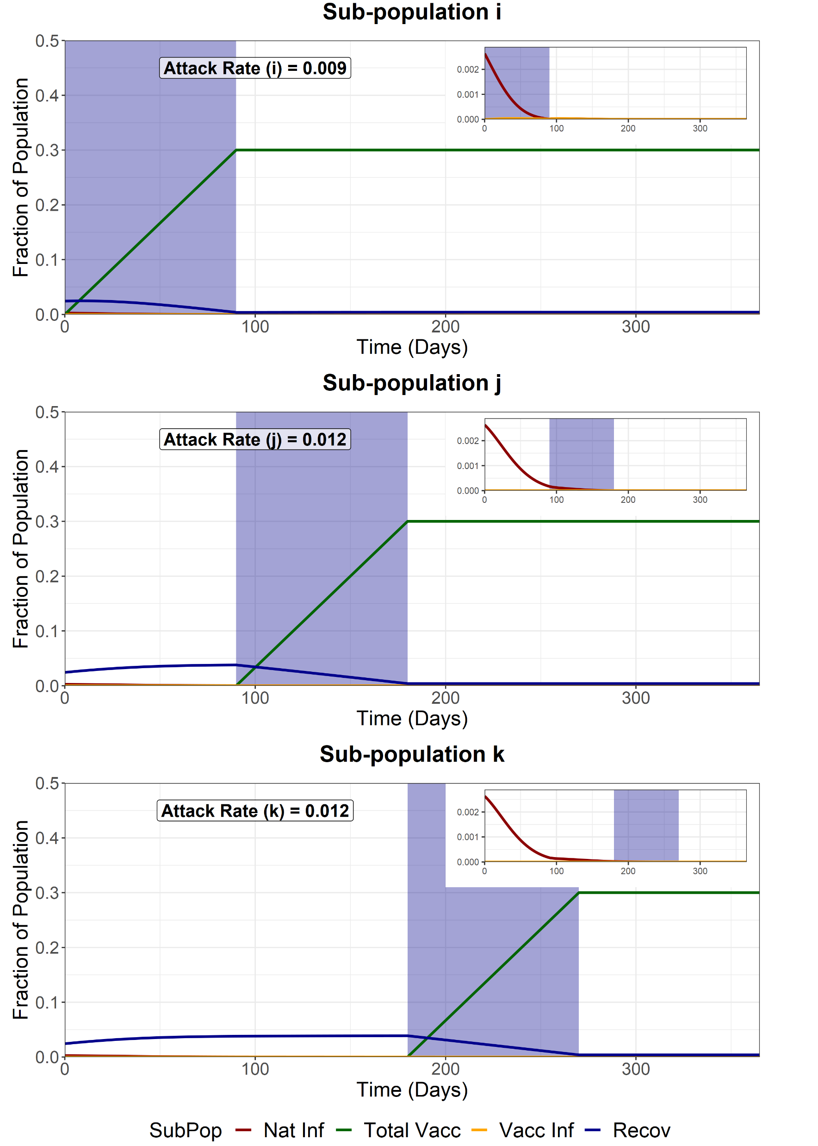
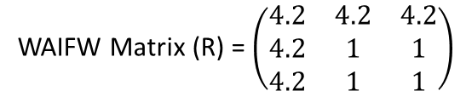
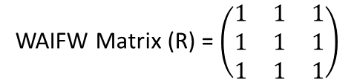
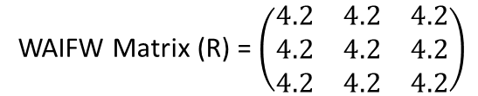
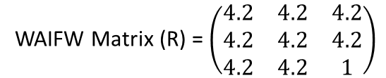
Sequential Vaccination
We model sequential vaccination of 3 sub-populations. Each vaccination schedule lasts 90 days and aims for 90% coverage of the available susceptibles, infecteds and recovereds at the beginning of the simulation. After vaccination of each subpopulation, the sub-population is released from NPIs, with the R increasing from 1 to 4.2.
Attack Rate for fully susceptible individuals infected in sub-group i (excluding infections amongst those vaccinated) = 0.0084
WAIFW Matrix (R) = $\left(\begin{matrix}1 & 1 & 1 \\ 1 & 1 & 1 \\ 1 & 1 & 1\end{matrix}\right)$
During the pop i vaccination (t = 0-90)
WAIFW Matrix (R) = $\left(\begin{matrix}4.2 & 4.2 & 4.2 \\ 4.2 & 1 & 1 \\ 4.2 & 1 & 1\end{matrix}\right)$
During the pop j vaccination (t = 90-180)
WAIFW Matrix (R) = $\left(\begin{matrix}4.2 & 4.2 & 4.2 \\ 4.2 & 4.2 & 4.2 \\ 4.2 & 4.2 & 1\end{matrix}\right)$
During the pop k vaccination (t = 180-270)
WAIFW Matrix (R) = $\left(\begin{matrix}4.2 & 4.2 & 4.2 \\ 4.2 & 4.2 & 4.2 \\ 4.2 & 4.2 & 4.2\end{matrix}\right)$
After final vaccination schedule (t = 270)

Slide 6
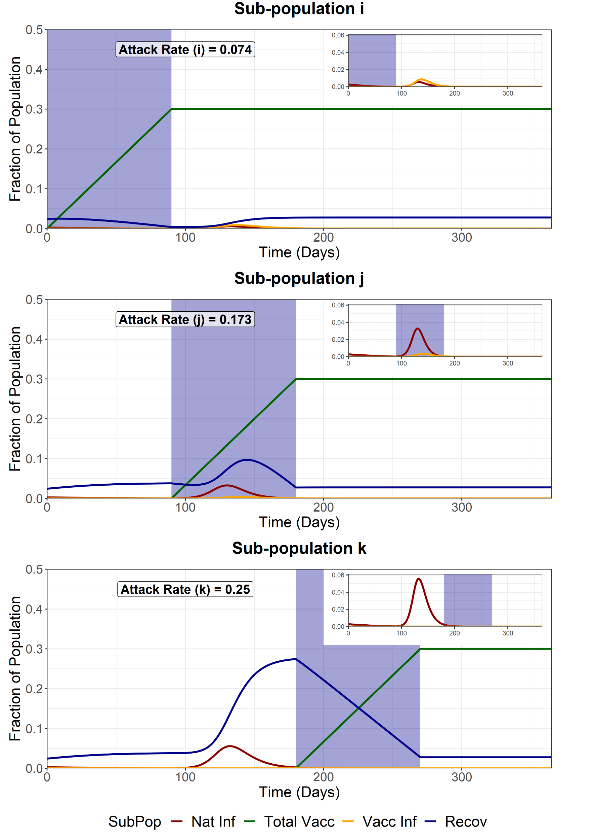
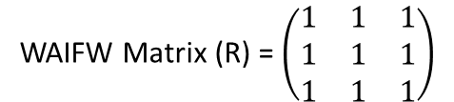
Full Release - First Group (i)
We model a full release of the entire population (i, j and k) after the vaccination of the first sub-population (i). This increases the R of the entire population from 1 to 4.2.
Attack Rate for fully susceptible individuals infected in sub-group i (excluding infections amongst those vaccinated) = 0.032
WAIFW Matrix (R) = $\left(\begin{matrix}1 & 1 & 1 \\ 1 & 1 & 1 \\ 1 & 1 & 1\end{matrix}\right)$
Before first vaccination schedule (t < 90)
WAIFW Matrix (R) = $\left(\begin{matrix}4.2 & 4.2 & 4.2 \\ 4.2 & 4.2 & 4.2 \\ 4.2 & 4.2 & 4.2\end{matrix}\right)$
After first vaccination schedule (t > 90)

Slide 7

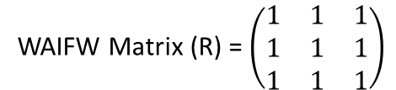
Full Release - Second Group (j)
We model a full release of the entire population (i, j and k) after the vaccination of the second sub-population (j). This increases the R of the entire population from 1 to 4.2.
Attack Rate for fully susceptible individuals infected in sub-group i (excluding infections amongst those vaccinated) = 0.0081
WAIFW Matrix (R) = $\left(\begin{matrix}1 & 1 & 1 \\ 1 & 1 & 1 \\ 1 & 1 & 1\end{matrix}\right)$
Before second vaccination schedule (t < 180)
WAIFW Matrix (R) = $\left(\begin{matrix}4.2 & 4.2 & 4.2 \\ 4.2 & 4.2 & 4.2 \\ 4.2 & 4.2 & 4.2\end{matrix}\right)$
After second vaccination schedule (t > 180)

Slide 8

Full Release - Third Group (k)
We model a full release of the entire population (i, j and k) after the vaccination of the last sub-population (k). This increases the R of the entire population from 1 to 4.2.
Attack Rate for fully susceptible individuals infected in sub-group i (excluding infections amongst those vaccinated) = 0.0081
WAIFW Matrix (R) = $\left(\begin{matrix}1 & 1 & 1 \\ 1 & 1 & 1 \\ 1 & 1 & 1\end{matrix}\right)$
Before final vaccination schedule (t < 270)
WAIFW Matrix (R) = $\left(\begin{matrix}4.2 & 4.2 & 4.2 \\ 4.2 & 4.2 & 4.2 \\ 4.2 & 4.2 & 4.2\end{matrix}\right)$
After final vaccination schedule (t > 270)

Slide 9
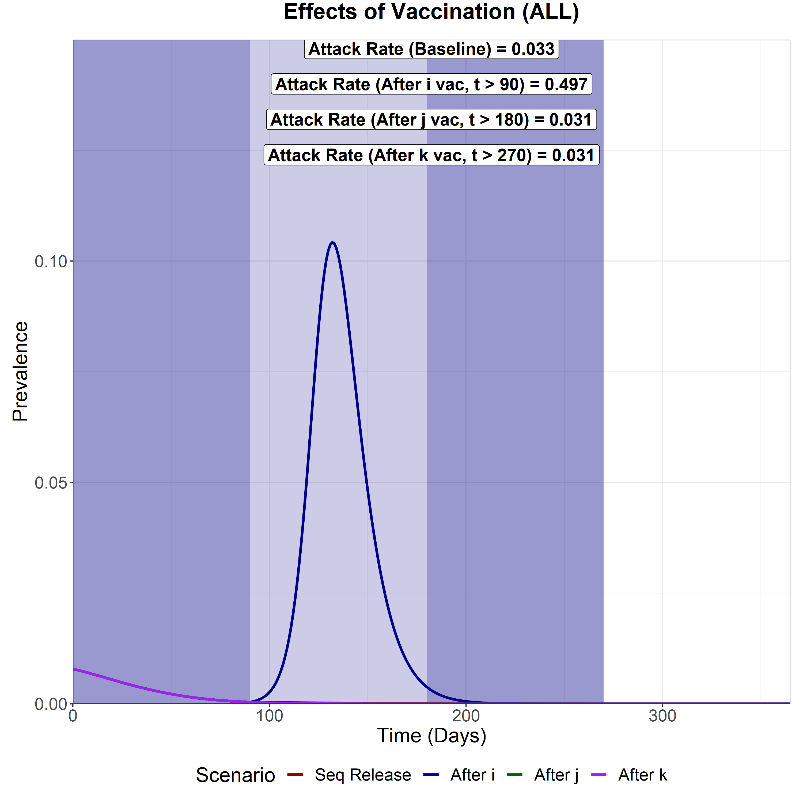
Scenario Analysis (Total Infected)
We now compare the total epidemic curve (the sum of the infectious compartment in each subpopulation) for 4 different scenarios:
With vaccination and sequential intervention release
Full release after vaccination of the first subpopulation (i)
Full release after vaccination of the second subpopulation (j)
Full release after vaccination of the last subpopulation (k)
The three shaded areas are the vaccination periods for subpopulation i, j and k respectively.
Sequential Vaccination
Attack Rate (i) – 0.009
Attack Rate (j) – 0.012
Attack Rate (k) – 0.012
Attack Rate for fully susceptible individuals infected in sub-group i = 0.0084
Full Release after vaccination of i
Attack Rate (i) – 0.074
Attack Rate (j) – 0.173
Attack Rate (k) – 0.25
Attack Rate for fully susceptible individuals infected in sub-group i = 0.032
Full Release after vaccination of j
Attack Rate (i) – 0.009
Attack Rate (j) – 0.011
Attack Rate (k) – 0.011
Attack Rate for fully susceptible individuals infected in sub-group i = 0.0081
Full Release after vaccination of k
Attack Rate (i) – 0.009
Attack Rate (j) – 0.011
Attack Rate (k) – 0.011
Attack Rate for fully susceptible individuals infected in sub-group i = 0.0081

Slide 10
HIGHER PRE-RELEASE R
Pre-release R is higher (R = 1.4) compared to baseline (R = 1.0)

Slide 11
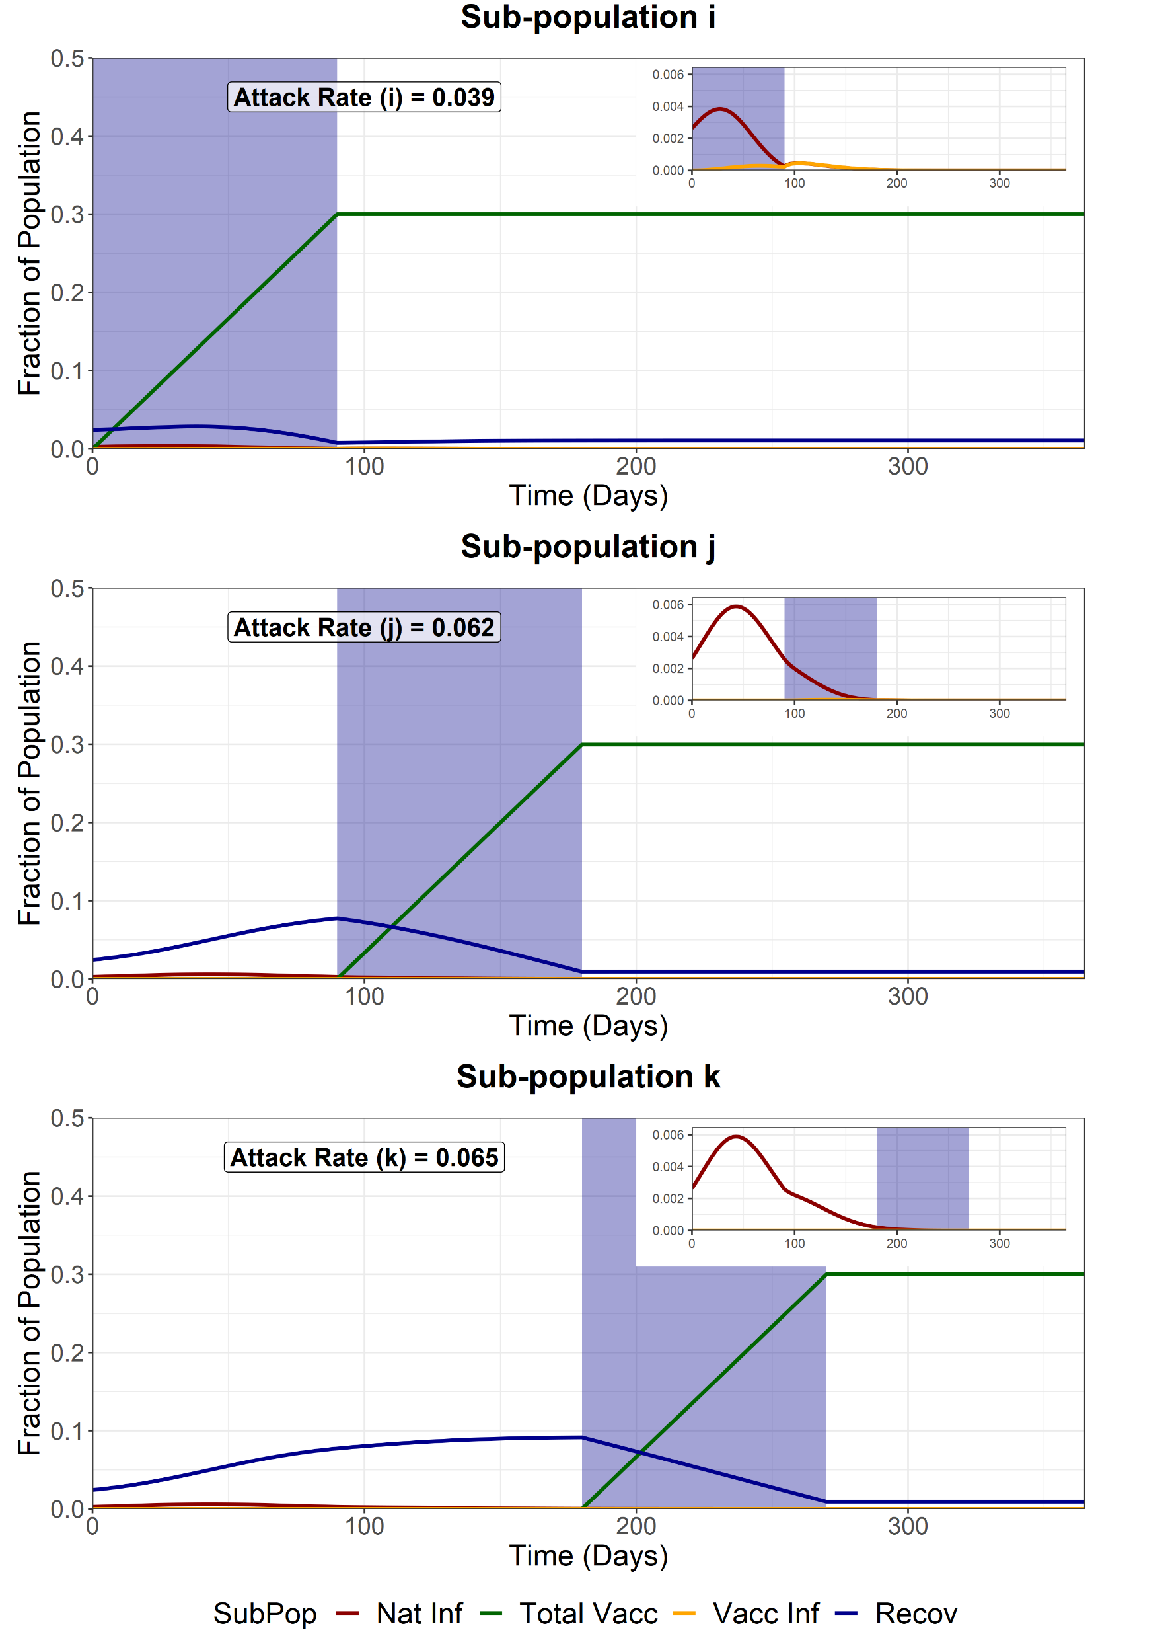
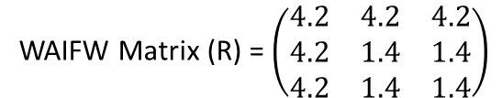
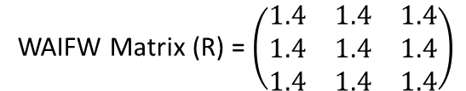
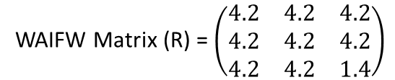
Sequential Vaccination
We model sequential vaccination of 3 sub-populations. Each vaccination schedule lasts 90 days and aims for 90% coverage of the available susceptibles, infecteds and recovereds at the beginning of the simulation. After vaccination of each subpopulation, the sub-population is released from NPIs, with the R increasing from 1.4 to 4.2.
Attack Rate for fully susceptible individuals infected in sub-group i (excluding infections amongst those vaccinated) = 0.0340
WAIFW Matrix (R) = $\left(\begin{matrix}1.4 & 1.4 & 1.4 \\ 1.4 & 1.4 & 1.4 \\ 1.4 & 1.4 & 1.4\end{matrix}\right)$
During the pop i vaccination (t = 0-90)
WAIFW Matrix (R) = $\left(\begin{matrix}4.2 & 4.2 & 4.2 \\ 4.2 & 1.4 & 1.4 \\ 4.2 & 1.4 & 1.4\end{matrix}\right)$
During the pop j vaccination (t = 90-180)
WAIFW Matrix (R) = $\left(\begin{matrix}4.2 & 4.2 & 4.2 \\ 4.2 & 4.2 & 4.2 \\ 4.2 & 4.2 & 1.4\end{matrix}\right)$
During the pop k vaccination (t = 180-270)
WAIFW Matrix (R) = $\left(\begin{matrix}4.2 & 4.2 & 4.2 \\ 4.2 & 4.2 & 4.2 \\ 4.2 & 4.2 & 4.2\end{matrix}\right)$
After final vaccination schedule (t = 270)

Slide 12
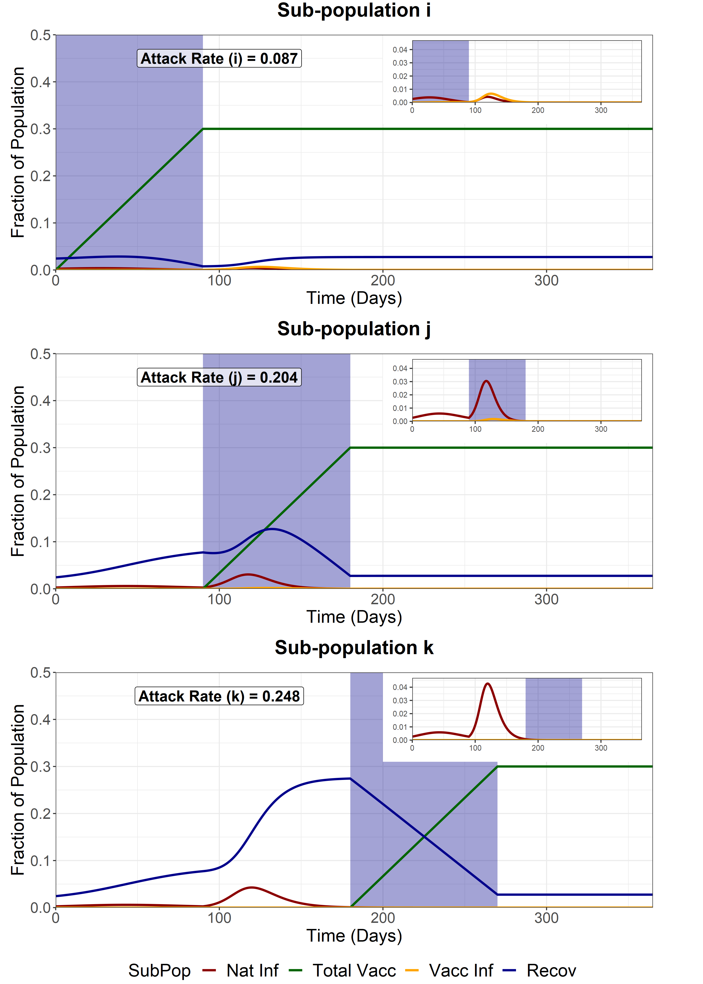
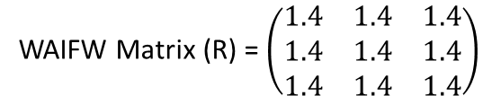
Full Release - First Group (i)
We model a full release of the entire population (i, j and k) after the vaccination of the first sub-population (i). This increases the R of the entire population from 1.4 to 4.2.
Attack Rate for fully susceptible individuals infected in sub-group i (excluding infections amongst those vaccinated) = 0.051
WAIFW Matrix (R) = $\left(\begin{matrix}1.4 & 1.4 & 1.4 \\ 1.4 & 1.4 & 1.4 \\ 1.4 & 1.4 & 1.4\end{matrix}\right)$
Before first vaccination schedule (t < 90)
WAIFW Matrix (R) = $\left(\begin{matrix}4.2 & 4.2 & 4.2 \\ 4.2 & 4.2 & 4.2 \\ 4.2 & 4.2 & 4.2\end{matrix}\right)$
After first vaccination schedule (t > 90)

Slide 13
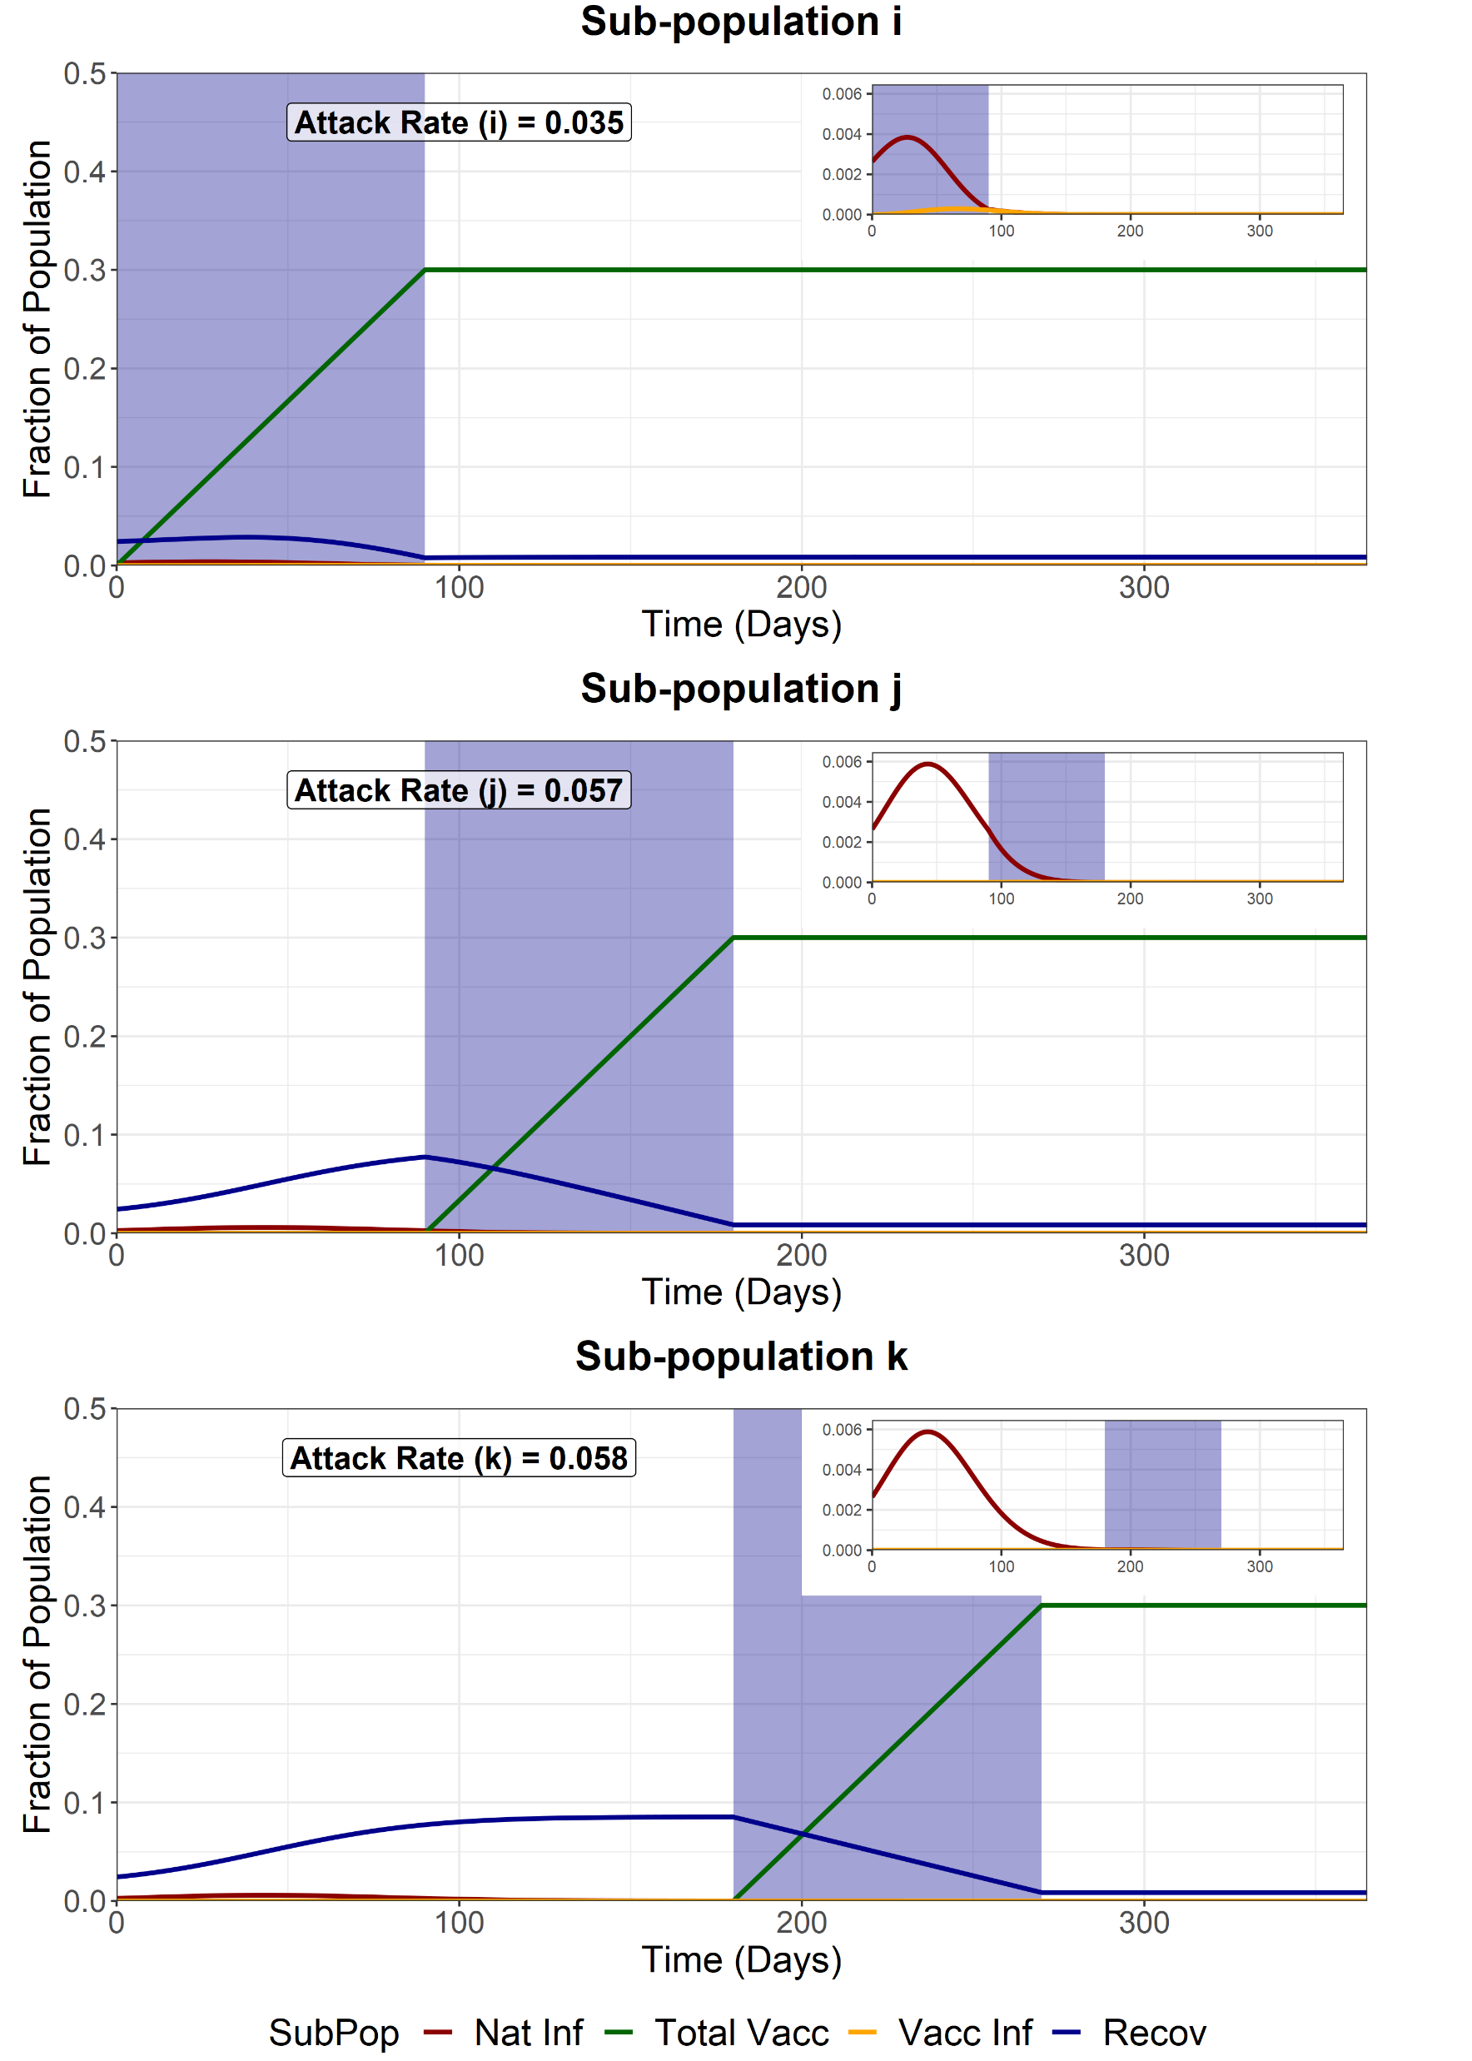
Full Release - Second Group (j)
We model a full release of the entire population (i, j and k) after the vaccination of the second sub-population (j). This increases the R of the entire population from 1.4 to 4.2.
Attack Rate for fully susceptible individuals infected in sub-group i (excluding infections amongst those vaccinated) = 0.0317
WAIFW Matrix (R) = $\left(\begin{matrix}1.4 & 1.4 & 1.4 \\ 1.4 & 1.4 & 1.4 \\ 1.4 & 1.4 & 1.4\end{matrix}\right)$
Before first vaccination schedule (t < 180)
WAIFW Matrix (R) = $\left(\begin{matrix}4.2 & 4.2 & 4.2 \\ 4.2 & 4.2 & 4.2 \\ 4.2 & 4.2 & 4.2\end{matrix}\right)$
After first vaccination schedule (t > 180)

Slide 14

Full Release - Third Group (k)
We model a full release of the entire population (i, j and k) after the vaccination of the last sub-population (k). This increases the R of the entire population from 1.4 to 4.2.
Attack Rate for fully susceptible individuals infected in sub-group i (excluding infections amongst those vaccinated) = 0.0317
WAIFW Matrix (R) = $\left(\begin{matrix}1.4 & 1.4 & 1.4 \\ 1.4 & 1.4 & 1.4 \\ 1.4 & 1.4 & 1.4\end{matrix}\right)$
Before final vaccination schedule (t < 270)
WAIFW Matrix (R) = $\left(\begin{matrix}4.2 & 4.2 & 4.2 \\ 4.2 & 4.2 & 4.2 \\ 4.2 & 4.2 & 4.2\end{matrix}\right)$
After final vaccination schedule (t > 270)

Slide 15
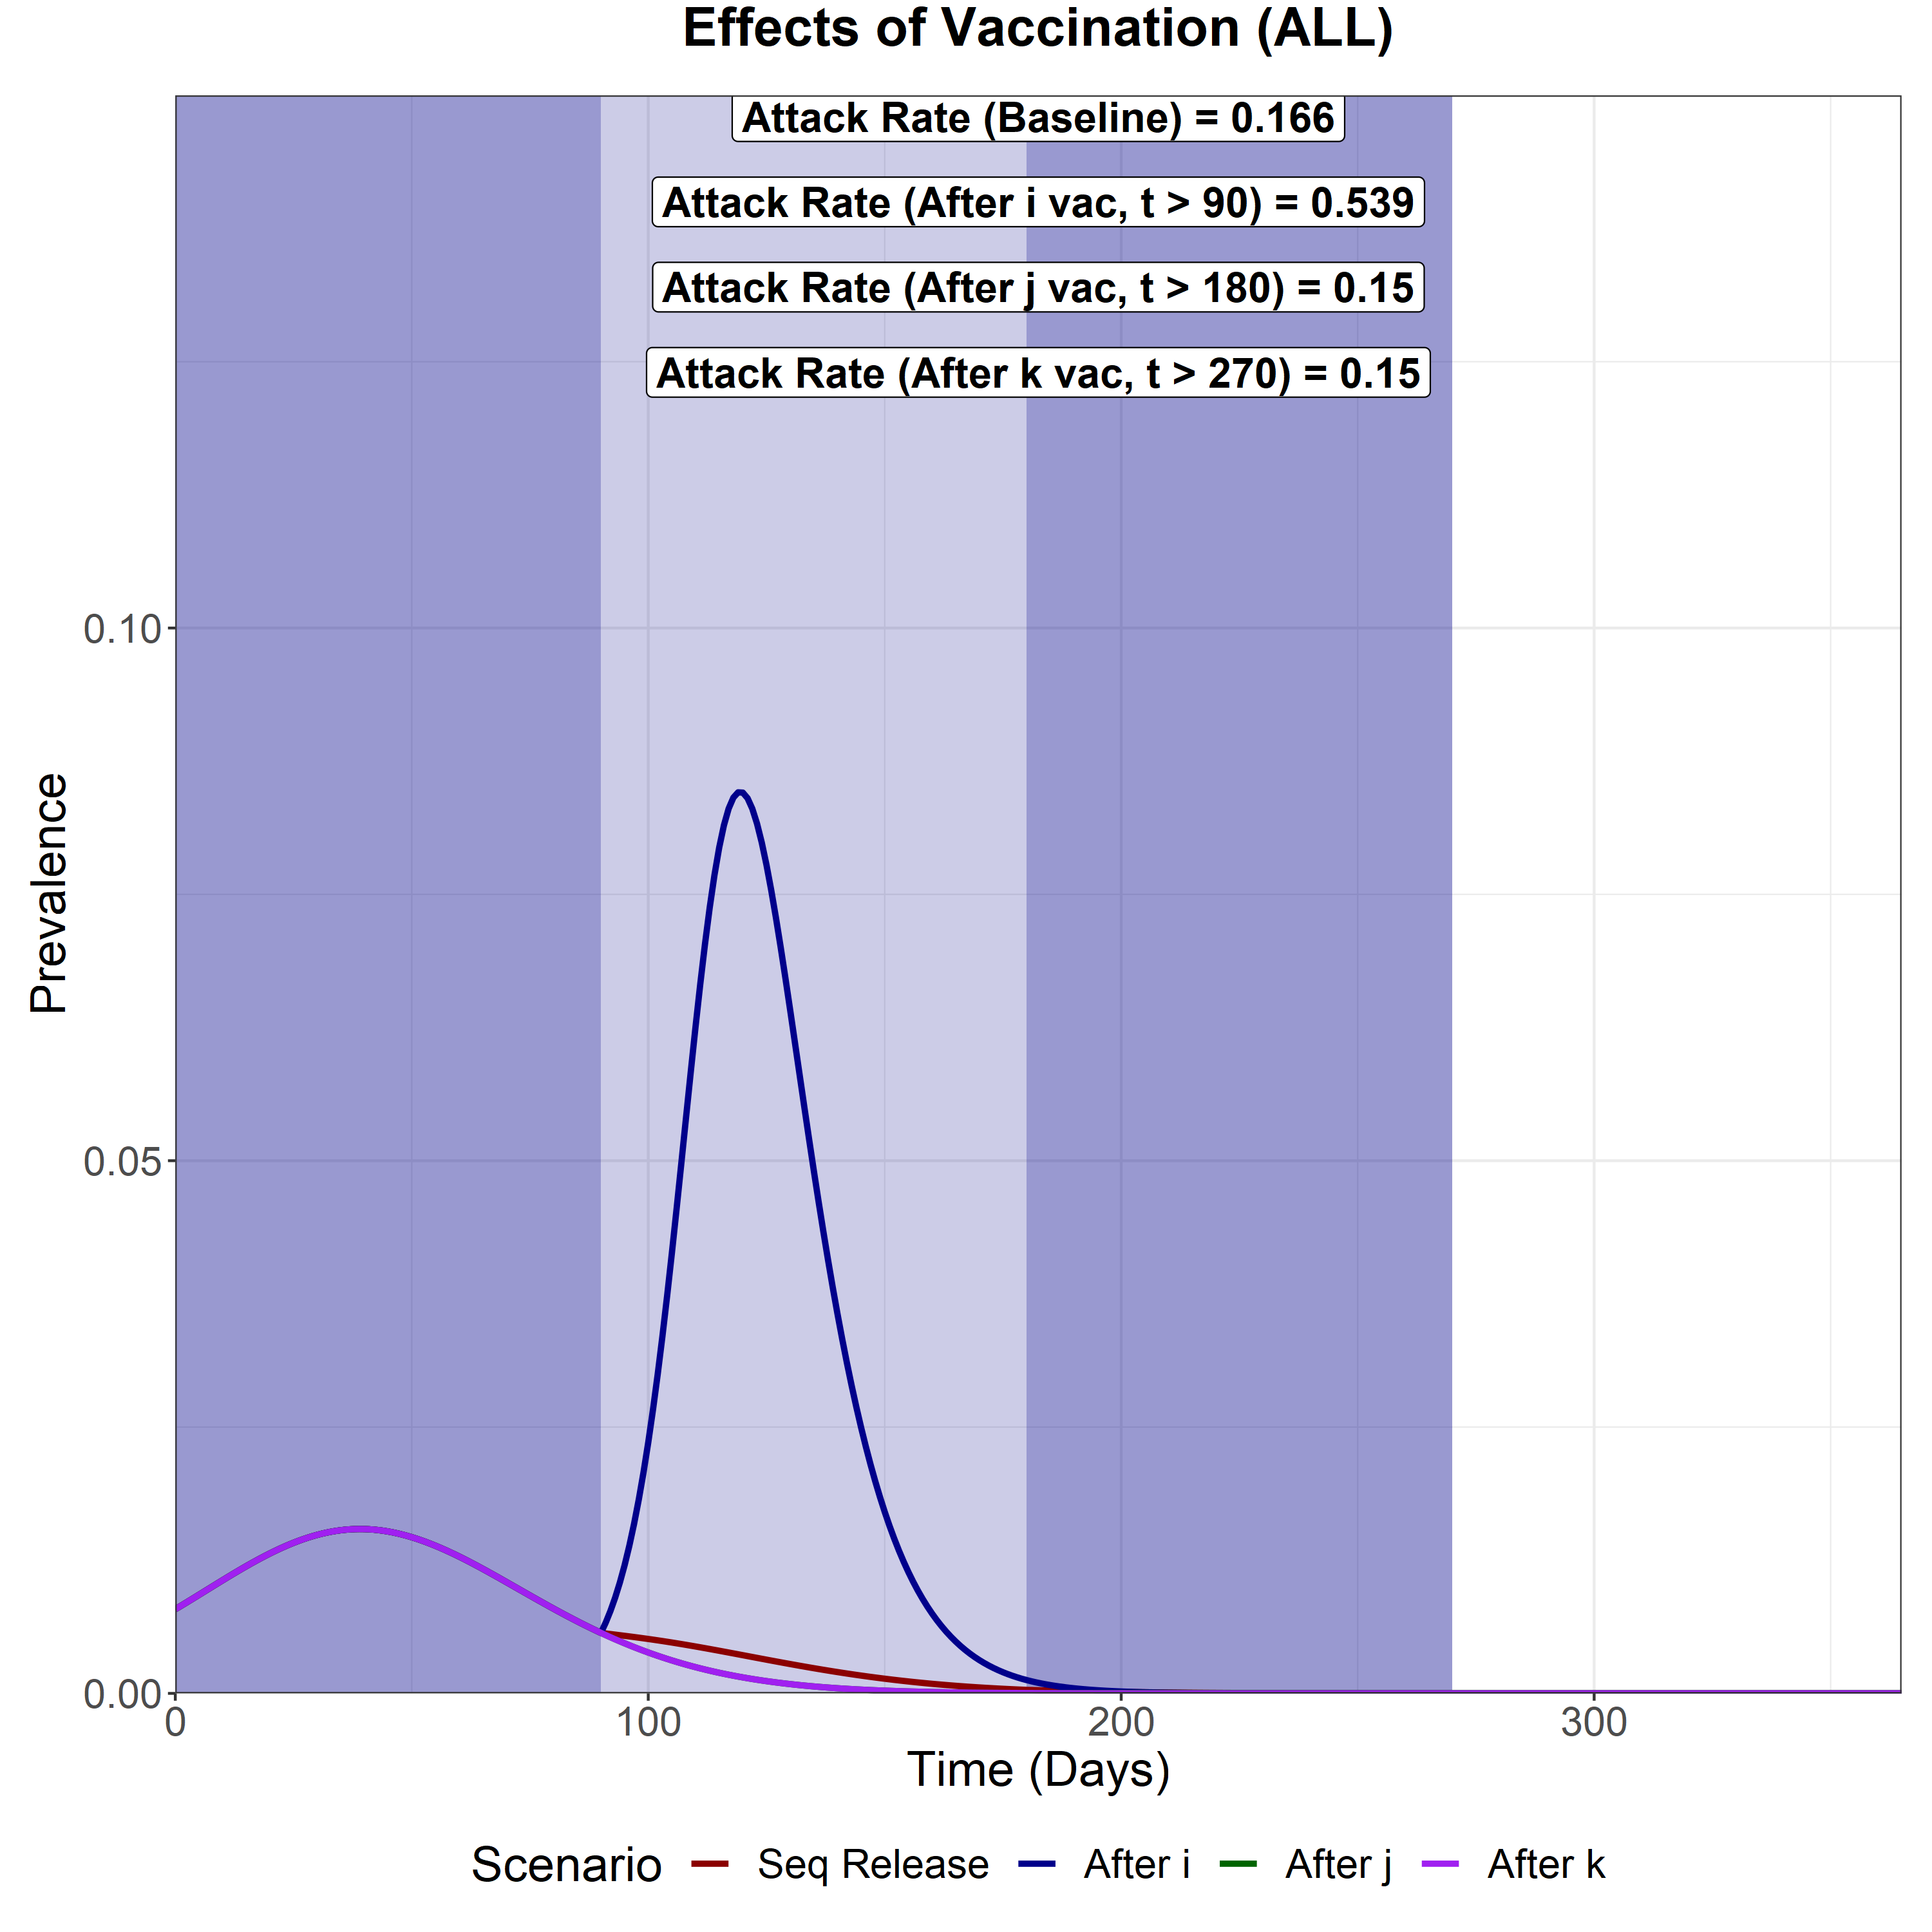
Scenario Analysis (Total Infected)
We now compare the total epidemic curve (the sum of the infectious compartment in each subpopulation) for 4 different scenarios:
With vaccination and sequential intervention release
Full release after vaccination of the first subpopulation (i)
Full release after vaccination of the second subpopulation (j)
Full release after vaccination of the last subpopulation (k)
The three shaded areas are the vaccination periods for subpopulation i, j and k respectively.
Sequential Vaccination
Attack Rate (i) – 0.039
Attack Rate (j) – 0.062
Attack Rate (k) - 0.065
Attack Rate for fully susceptible individuals infected in sub-group i = 0.0340
Full Release after vaccination of i
Attack Rate (i) – 0.087
Attack Rate (j) – 0.204
Attack Rate (k) – 0.248
Attack Rate for fully susceptible individuals infected in sub-group i = 0.051
Full Release after vaccination of j
Attack Rate (i) – 0.035
Attack Rate (j) – 0.057
Attack Rate (k) – 0.058
Attack Rate for fully susceptible individuals infected in sub-group i = 0.0317
Full Release after vaccination of k
Attack Rate (i) – 0.035
Attack Rate (j) – 0.057
Attack Rate (k) – 0.058
Attack Rate for fully susceptible individuals infected in sub-group i = 0.0317

Slide 16
PARTIAL RELAXATION
R is only released from 1 to 1.8 (25% to the baseline R release of 4.2)

Slide 17

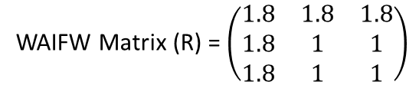
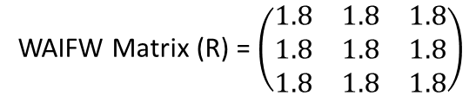
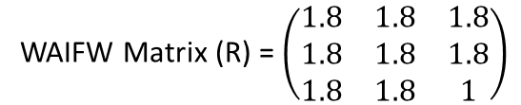
Sequential Vaccination
We model sequential vaccination of 3 sub-populations. Each vaccination schedule lasts 90 days and aims for 90% coverage of the available susceptibles, infecteds and recovereds at the beginning of the simulation. After vaccination of each subpopulation, the sub-population is released from NPIs, with the R increasing from 1 to 1.8. This is 25% between 1 and the baseline of 4.2, representing a weaker NPI release.
Attack Rate for fully susceptible individuals infected in sub-group i (excluding infections amongst those vaccinated) = 0.0082
WAIFW Matrix (R) = $\left(\begin{matrix}1 & 1 & 1 \\ 1 & 1 & 1 \\ 1 & 1 & 1\end{matrix}\right)$
During the pop i vaccination (t = 0-90)
WAIFW Matrix (R) = $\left(\begin{matrix}1.8 & 1.8 & 1.8 \\ 1.8 & 1 & 1 \\ 1.8 & 1 & 1\end{matrix}\right)$
During the pop j vaccination (t = 90-180)
WAIFW Matrix (R) = $\left(\begin{matrix}1.8 & 1.8 & 1.8 \\ 1.8 & 1.8 & 1.8 \\ 1.8 & 1.8 & 1\end{matrix}\right)$
During the pop k vaccination (t = 180-270)
WAIFW Matrix (R) = $\left(\begin{matrix}1.8 & 1.8 & 1.8 \\ 1.8 & 1.8 & 1.8 \\ 1.8 & 1.8 & 1.8\end{matrix}\right)$
After final vaccination schedule (t = 270)

Slide 18

Full Release - First Group (i)
We model a full release of the entire population (i, j and k) after the vaccination of the first sub-population (i). This increases the R of the entire population from 1 to 1.8. This is 25% between 1 and the baseline of 4.2, representing a weaker NPI release.
Attack Rate for fully susceptible individuals infected in sub-group i (excluding infections amongst those vaccinated) = 0.0083
WAIFW Matrix (R) = $\left(\begin{matrix}1 & 1 & 1 \\ 1 & 1 & 1 \\ 1 & 1 & 1\end{matrix}\right)$
Before first vaccination schedule (t < 90)
WAIFW Matrix (R) = $\left(\begin{matrix}1.8 & 1.8 & 1.8 \\ 1.8 & 1.8 & 1.8 \\ 1.8 & 1.8 & 1.8\end{matrix}\right)$
After first vaccination schedule (t > 90)

Slide 19

Full Release - Second Group (j)
We model a full release of the entire population (i, j and k) after the vaccination of the second sub-population (j). This increases the R of the entire population from 1 to 1.8. This is 25% between 1 and the baseline of 4.2, representing a weaker NPI release.
Attack Rate for fully susceptible individuals infected in sub-group i (excluding infections amongst those vaccinated) = 0.008
WAIFW Matrix (R) = $\left(\begin{matrix}1 & 1 & 1 \\ 1 & 1 & 1 \\ 1 & 1 & 1\end{matrix}\right)$
Before second vaccination schedule (t < 180)
WAIFW Matrix (R) = $\left(\begin{matrix}1.8 & 1.8 & 1.8 \\ 1.8 & 1.8 & 1.8 \\ 1.8 & 1.8 & 1.8\end{matrix}\right)$
After second vaccination schedule (t > 180)

Slide 20

Full Release - Third Group (k)
We model a full release of the entire population (i, j and k) after the vaccination of the last sub-population (k). This increases the R of the entire population from 1 to 1.8. This is 25% between 1 and the baseline of 4.2, representing a weaker NPI release.
Attack Rate for fully susceptible individuals infected in sub-group i (excluding infections amongst those vaccinated) = 0.008
WAIFW Matrix (R) = $\left(\begin{matrix}1 & 1 & 1 \\ 1 & 1 & 1 \\ 1 & 1 & 1\end{matrix}\right)$
Before final vaccination schedule (t < 270)
WAIFW Matrix (R) = $\left(\begin{matrix}1.8 & 1.8 & 1.8 \\ 1.8 & 1.8 & 1.8 \\ 1.8 & 1.8 & 1.8\end{matrix}\right)$
After final vaccination schedule (t > 270)

Slide 21

Scenario Analysis (Total Infected)
We now compare the total epidemic curve (the sum of the infectious compartment in each subpopulation) for 4 different scenarios:
With vaccination and sequential intervention release
Full release after vaccination of the first subpopulation (i)
Full release after vaccination of the second subpopulation (j)
Full release after vaccination of the last subpopulation (k)
The three shaded areas are the vaccination periods for subpopulation i, j and k respectively.
Sequential Vaccination
Attack Rate (i) – 0.009
Attack Rate (j) – 0.011
Attack Rate (k) – 0.011
Attack Rate for fully susceptible individuals infected in sub-group i = 0.0082
Full Release after vaccination of i
Attack Rate (i) – 0.009
Attack Rate (j) – 0.012
Attack Rate (k) – 0.013
Attack Rate for fully susceptible individuals infected in sub-group i = 0.0083
Full Release after vaccination of j
Attack Rate (i) – 0.009
Attack Rate (j) – 0.011
Attack Rate (k) – 0.011
Attack Rate for fully susceptible individuals infected in sub-group i = 0.008
Full Release after vaccination of k
Attack Rate (i) – 0.009
Attack Rate (j) – 0.011
Attack Rate (k) – 0.011
Attack Rate for fully susceptible individuals infected in sub-group i = 0.008

Slide 22
PARTIAL RELAXATION
R is only released from 1 to 2.6 (halfway to the baseline R release of 4.2)

Slide 23

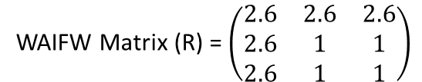
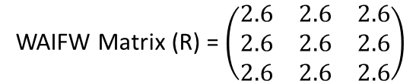
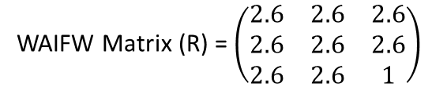
Sequential Vaccination
We model sequential vaccination of 3 sub-populations. Each vaccination schedule lasts 90 days and aims for 90% coverage of the available susceptibles, infecteds and recovereds at the beginning of the simulation. After vaccination of each subpopulation, the sub-population is released from NPIs, with the R increasing from 1 to 2.6. This is halfway between 1 and the baseline of 4.2, representing a weaker NPI release.
Attack Rate for fully susceptible individuals infected in sub-group i (excluding infections amongst those vaccinated) = 0.0082
WAIFW Matrix (R) = $\left(\begin{matrix}1 & 1 & 1 \\ 1 & 1 & 1 \\ 1 & 1 & 1\end{matrix}\right)$
During the pop i vaccination (t = 0-90)
WAIFW Matrix (R) = $\left(\begin{matrix}2.6 & 2.6 & 2.6 \\ 2.6 & 1 & 1 \\ 2.6 & 1 & 1\end{matrix}\right)$
During the pop j vaccination (t = 90-180)
WAIFW Matrix (R) = $\left(\begin{matrix}2.6 & 2.6 & 2.6 \\ 2.6 & 2.6 & 2.6 \\ 2.6 & 2.6 & 1\end{matrix}\right)$
During the pop k vaccination (t = 180-270)
WAIFW Matrix (R) = $\left(\begin{matrix}2.6 & 2.6 & 2.6 \\ 2.6 & 2.6 & 2.6 \\ 2.6 & 2.6 & 2.6\end{matrix}\right)$
After final vaccination schedule (t = 270)

Slide 24
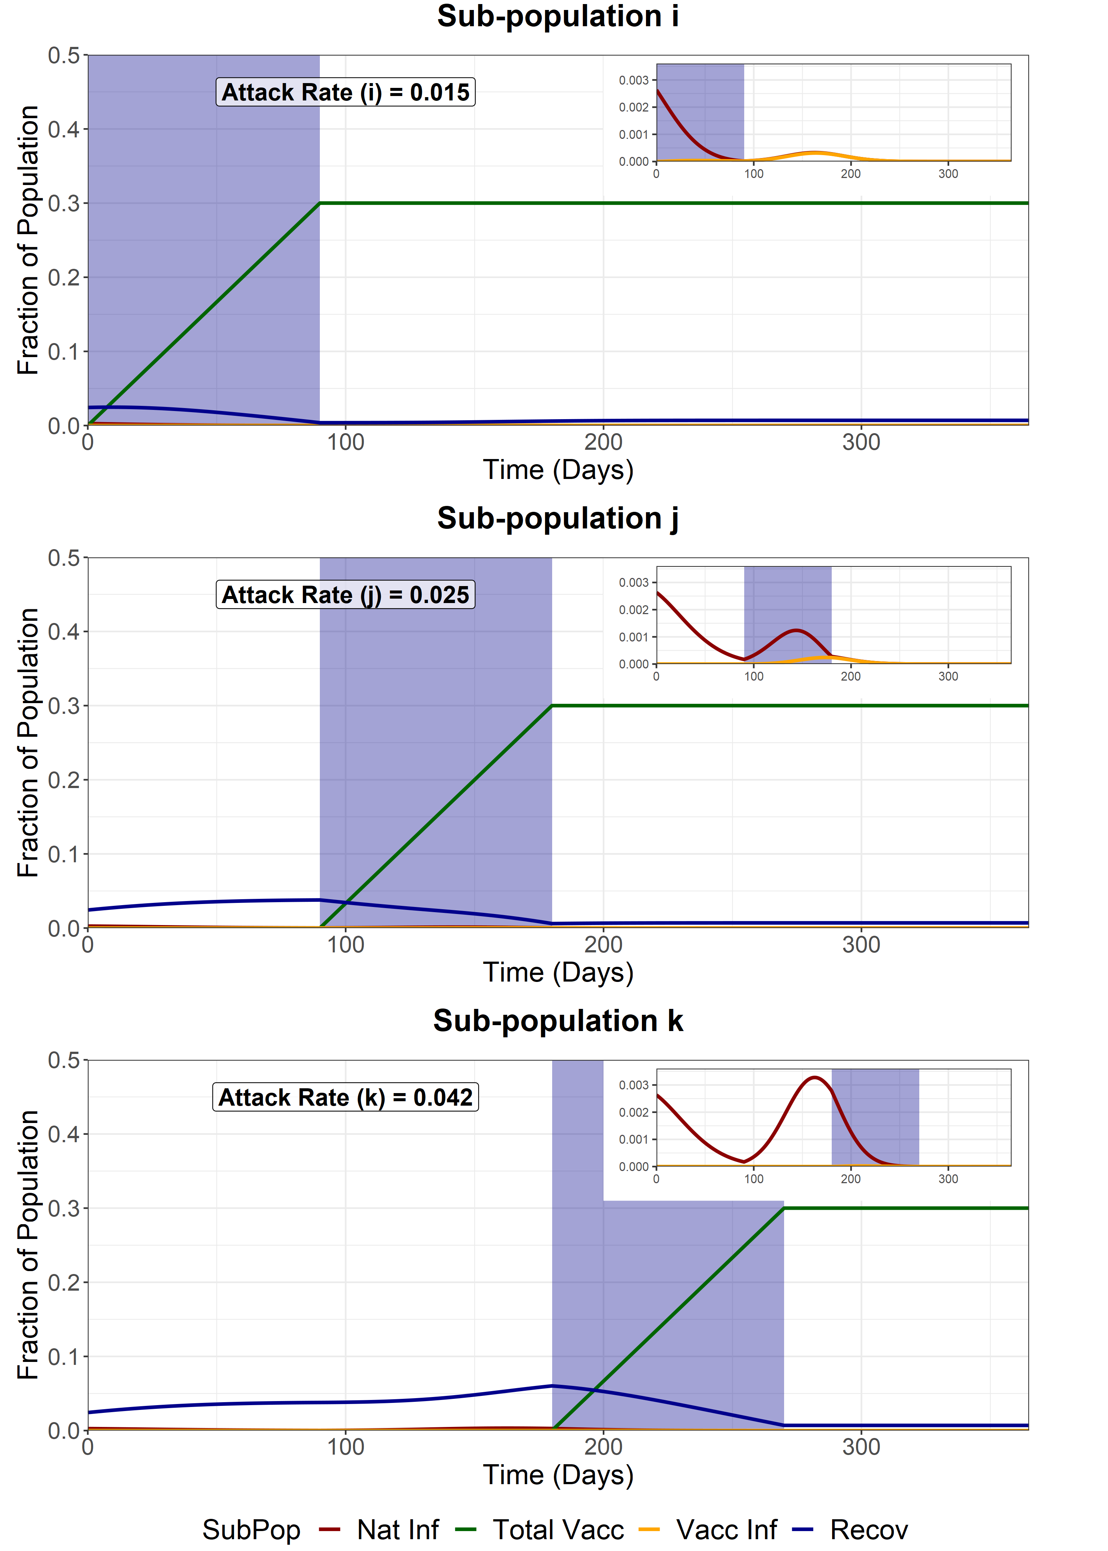
Full Release - First Group (i)
We model a full release of the entire population (i, j and k) after the vaccination of the first sub-population (i). This increases the R of the entire population from 1 to 2.6. This is halfway between 1 and the baseline of 4.2, representing a weaker NPI release.
Attack Rate for fully susceptible individuals infected in sub-group i (excluding infections amongst those vaccinated) = 0.0113
WAIFW Matrix (R) = $\left(\begin{matrix}1 & 1 & 1 \\ 1 & 1 & 1 \\ 1 & 1 & 1\end{matrix}\right)$
Before first vaccination schedule (t < 90)
WAIFW Matrix (R) = $\left(\begin{matrix}2.6 & 2.6 & 2.6 \\ 2.6 & 2.6 & 2.6 \\ 2.6 & 2.6 & 2.6\end{matrix}\right)$
After first vaccination schedule (t > 90)

Slide 25

Full Release - Second Group (j)
We model a full release of the entire population (i, j and k) after the vaccination of the second sub-population (j). This increases the R of the entire population from 1 to 2.6. This is halfway between 1 and the baseline of 4.2, representing a weaker NPI release.
Attack Rate for fully susceptible individuals infected in sub-group i (excluding infections amongst those vaccinated) = 0.0082
WAIFW Matrix (R) = $\left(\begin{matrix}1 & 1 & 1 \\ 1 & 1 & 1 \\ 1 & 1 & 1\end{matrix}\right)$
Before second vaccination schedule (t < 180)
WAIFW Matrix (R) = $\left(\begin{matrix}2.6 & 2.6 & 2.6 \\ 2.6 & 2.6 & 2.6 \\ 2.6 & 2.6 & 2.6\end{matrix}\right)$
After second vaccination schedule (t > 180)

Slide 26
Full Release - Third Group (k)
We model a full release of the entire population (i, j and k) after the vaccination of the last sub-population (k). This increases the R of the entire population from 1 to 2.6. This is halfway between 1 and the baseline of 4.2, representing a weaker NPI release.
Attack Rate for fully susceptible individuals infected in sub-group i (excluding infections amongst those vaccinated) = 0.0082
WAIFW Matrix (R) = $\left(\begin{matrix}1 & 1 & 1 \\ 1 & 1 & 1 \\ 1 & 1 & 1\end{matrix}\right)$
Before final vaccination schedule (t < 270)
WAIFW Matrix (R) = $\left(\begin{matrix}2.6 & 2.6 & 2.6 \\ 2.6 & 2.6 & 2.6 \\ 2.6 & 2.6 & 2.6\end{matrix}\right)$
After final vaccination schedule (t > 270)

Slide 27

Scenario Analysis (Total Infected)
We now compare the total epidemic curve (the sum of the infectious compartment in each subpopulation) for 4 different scenarios:
With vaccination and sequential intervention release
Full release after vaccination of the first subpopulation (i)
Full release after vaccination of the second subpopulation (j)
Full release after vaccination of the last subpopulation (k)
The three shaded areas are the vaccination periods for subpopulation i, j and k respectively.
Sequential Vaccination
Attack Rate (i) – 0.009
Attack Rate (j) – 0.011
Attack Rate (k) – 0.011
Attack Rate for fully susceptible individuals infected in sub-group i = 0.0082
Full Release after vaccination of i
Attack Rate (i) – 0.015
Attack Rate (j) – 0.025
Attack Rate (k) – 0.042
Attack Rate for fully susceptible individuals infected in sub-group i = 0.0113
Full Release after vaccination of j
Attack Rate (i) – 0.009
Attack Rate (j) – 0.011
Attack Rate (k) – 0.011
Attack Rate for fully susceptible individuals infected in sub-group i = 0.0082
Full Release after vaccination of k
Attack Rate (i) – 0.009
Attack Rate (j) – 0.011
Attack Rate (k) – 0.011
Attack Rate for fully susceptible individuals infected in sub-group i = 0.0082

Slide 28
DECREASED INTER-GROUP MIXING
R on the non-diagonal elements of the WAIFW matrix is half relative to a baseline NPI release.

Slide 29

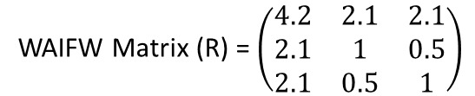
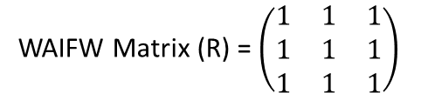
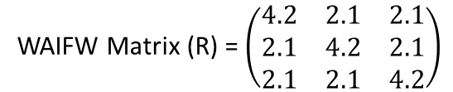
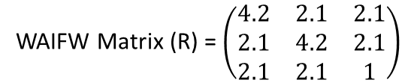
Sequential Vaccination
We model sequential vaccination of 3 sub-populations. Each vaccination schedule lasts 90 days and aims for 90% coverage of the available susceptibles, infecteds and recovereds at the beginning of the simulation. After vaccination of each subpopulation, the sub-population is released from NPIs, with the R increasing from 1 to 4.2 within groups (diagonal elements and 1 to 2.1 between groups (non-diagonal elements). This represents a lifting of NPIs, but with some restrictions still occuring between subpopulations.
Attack Rate for fully susceptible individuals infected in sub-group i (excluding infections amongst those vaccinated) = 0.0082
WAIFW Matrix (R) = $\left(\begin{matrix}1 & 1 & 1 \\ 1 & 1 & 1 \\ 1 & 1 & 1\end{matrix}\right)$
During the pop i vaccination (t = 0-90)
WAIFW Matrix (R) = $\left(\begin{matrix}4.2 & 2.1 & 2.1 \\ 2.1 & 1 & 0.5 \\ 2.1 & 0.5 & 1\end{matrix}\right)$
During the pop j vaccination (t = 90-180)
WAIFW Matrix (R) = $\left(\begin{matrix}4.2 & 2.1 & 2.1 \\ 2.1 & 4.2 & 2.1 \\ 2.1 & 2.1 & 1\end{matrix}\right)$
During the pop k vaccination (t = 180-270)
WAIFW Matrix (R) = $\left(\begin{matrix}4.2 & 2.1 & 2.1 \\ 2.1 & 4.2 & 2.1 \\ 2.1 & 2.1 & 4.2\end{matrix}\right)$
After final vaccination schedule (t = 270)

Slide 30
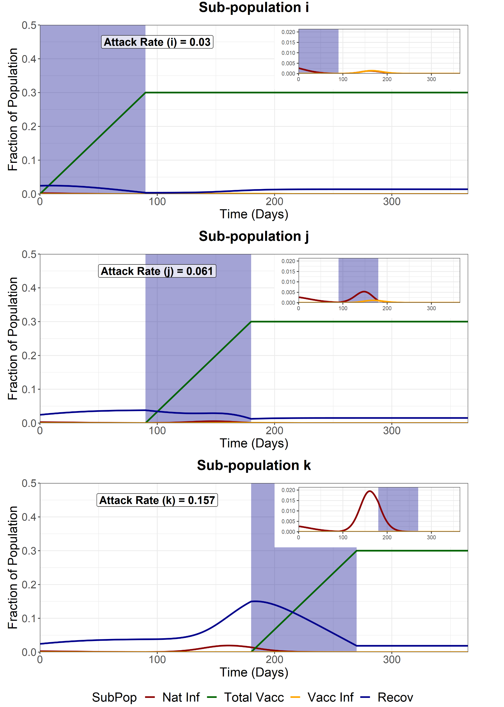
Full Release - First Group (i)
We model a full release of the entire population (i, j and k) after the vaccination of the first sub-population (i). However, the a full release allows for a R increase from 1 to 4.2 within groups (diagonal elements, but only from 1 to 2.1 between groups (non-diagonal elements). This represents a lifting of NPIsm but with some restrictions still occuring between subpopulations.
Attack Rate for fully susceptible individuals infected in sub-group i (excluding infections amongst those vaccinated) = 0.0183
WAIFW Matrix (R) = $\left(\begin{matrix}1 & 1 & 1 \\ 1 & 1 & 1 \\ 1 & 1 & 1\end{matrix}\right)$
Before first vaccination schedule (t < 90)
WAIFW Matrix (R) = $\left(\begin{matrix}4.2 & 2.1 & 2.1 \\ 2.1 & 4.2 & 2.1 \\ 2.1 & 2.1 & 4.2\end{matrix}\right)$
After first vaccination schedule (t > 90)

Slide 31

Full Release - Second Group (j)
We model a full release of the entire population (i, j and k) after the vaccination of the second sub-population (j). This increases the R of the entire population from 1 to 2.6. This is halfway between 1 and the baseline of 4.2, representing a weaker NPI release.
Attack Rate for fully susceptible individuals infected in sub-group i (excluding infections amongst those vaccinated) = 0.0082
WAIFW Matrix (R) = $\left(\begin{matrix}1 & 1 & 1 \\ 1 & 1 & 1 \\ 1 & 1 & 1\end{matrix}\right)$
Before second vaccination schedule (t < 180)
WAIFW Matrix (R) = $\left(\begin{matrix}4.2 & 2.1 & 2.1 \\ 2.1 & 4.2 & 2.1 \\ 2.1 & 2.1 & 4.2\end{matrix}\right)$
After second vaccination schedule (t > 180)

Slide 32
Full Release - Third Group (k)
We model a full release of the entire population (i, j and k) after the vaccination of the last sub-population (k). This increases the R of the entire population from 1 to 2.6. This is halfway between 1 and the baseline of 4.2, representing a weaker NPI release.
Attack Rate for fully susceptible individuals infected in sub-group i (excluding infections amongst those vaccinated) = 0.0082
WAIFW Matrix (R) = $\left(\begin{matrix}1 & 1 & 1 \\ 1 & 1 & 1 \\ 1 & 1 & 1\end{matrix}\right)$
Before final vaccination schedule (t < 270)
WAIFW Matrix (R) = $\left(\begin{matrix}4.2 & 2.1 & 2.1 \\ 2.1 & 4.2 & 2.1 \\ 2.1 & 2.1 & 4.2\end{matrix}\right)$
After final vaccination schedule (t > 270)

Slide 33
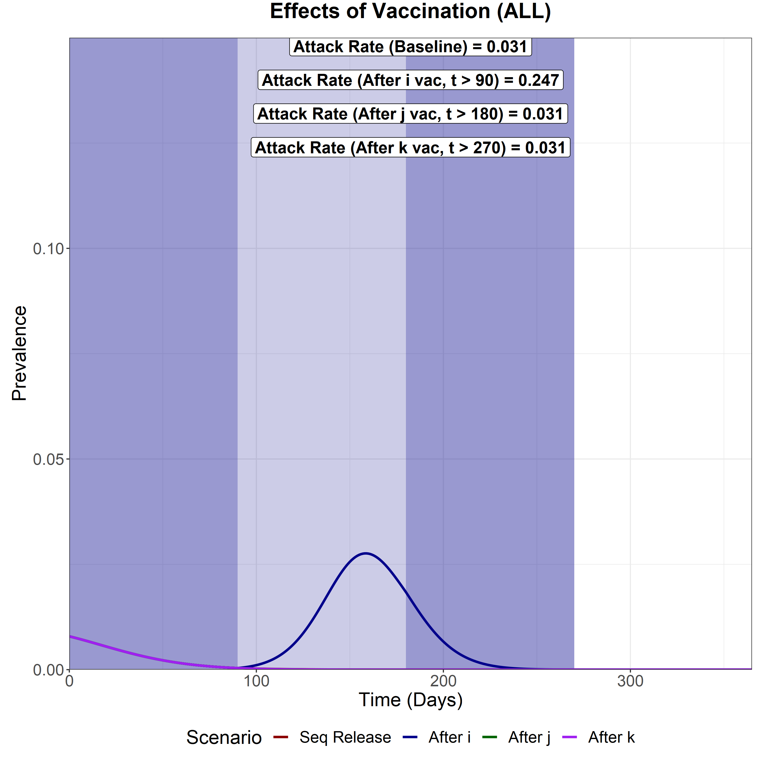
Scenario Analysis (Total Infected)
We now compare the total epidemic curve (the sum of the infectious compartment in each subpopulation) for 4 different scenarios:
With vaccination and sequential intervention release
Full release after vaccination of the first subpopulation (i)
Full release after vaccination of the second subpopulation (j)
Full release after vaccination of the last subpopulation (k)
The three shaded areas are the vaccination periods for subpopulation i, j and k respectively.
Sequential Vaccination
Attack Rate (i) – 0.009
Attack Rate (j) – 0.011
Attack Rate (k) – 0.011
Attack Rate for fully susceptible individuals infected in sub-group i = 0.0082
Full Release after vaccination of i
Attack Rate (i) – 0.03
Attack Rate (j) – 0.061
Attack Rate (k) – 0.157
Attack Rate for fully susceptible individuals infected in sub-group i = 0.0183
Full Release after vaccination of j
Attack Rate (i) – 0.009
Attack Rate (j) – 0.011
Attack Rate (k) – 0.011
Attack Rate for fully susceptible individuals infected in sub-group i = 0.0082
Full Release after vaccination of k
Attack Rate (i) – 0.009
Attack Rate (j) – 0.011
Attack Rate (k) – 0.011
Attack Rate for fully susceptible individuals infected in sub-group i = 0.0082

Slide 34
LOSS OF NATURAL IMMUNITY, VACCINE IMMUNITY AND BOTH
Waning immunity is modelled in those who are natural infected (σ₂ = 1/6 months⁻¹), vaccinated (σ₁ = 1/6 months⁻¹) and then both are modelled in tandem (both σ₁ = 1/6 months⁻¹ and σ₂ = 1/6 months⁻¹)

Slide 35

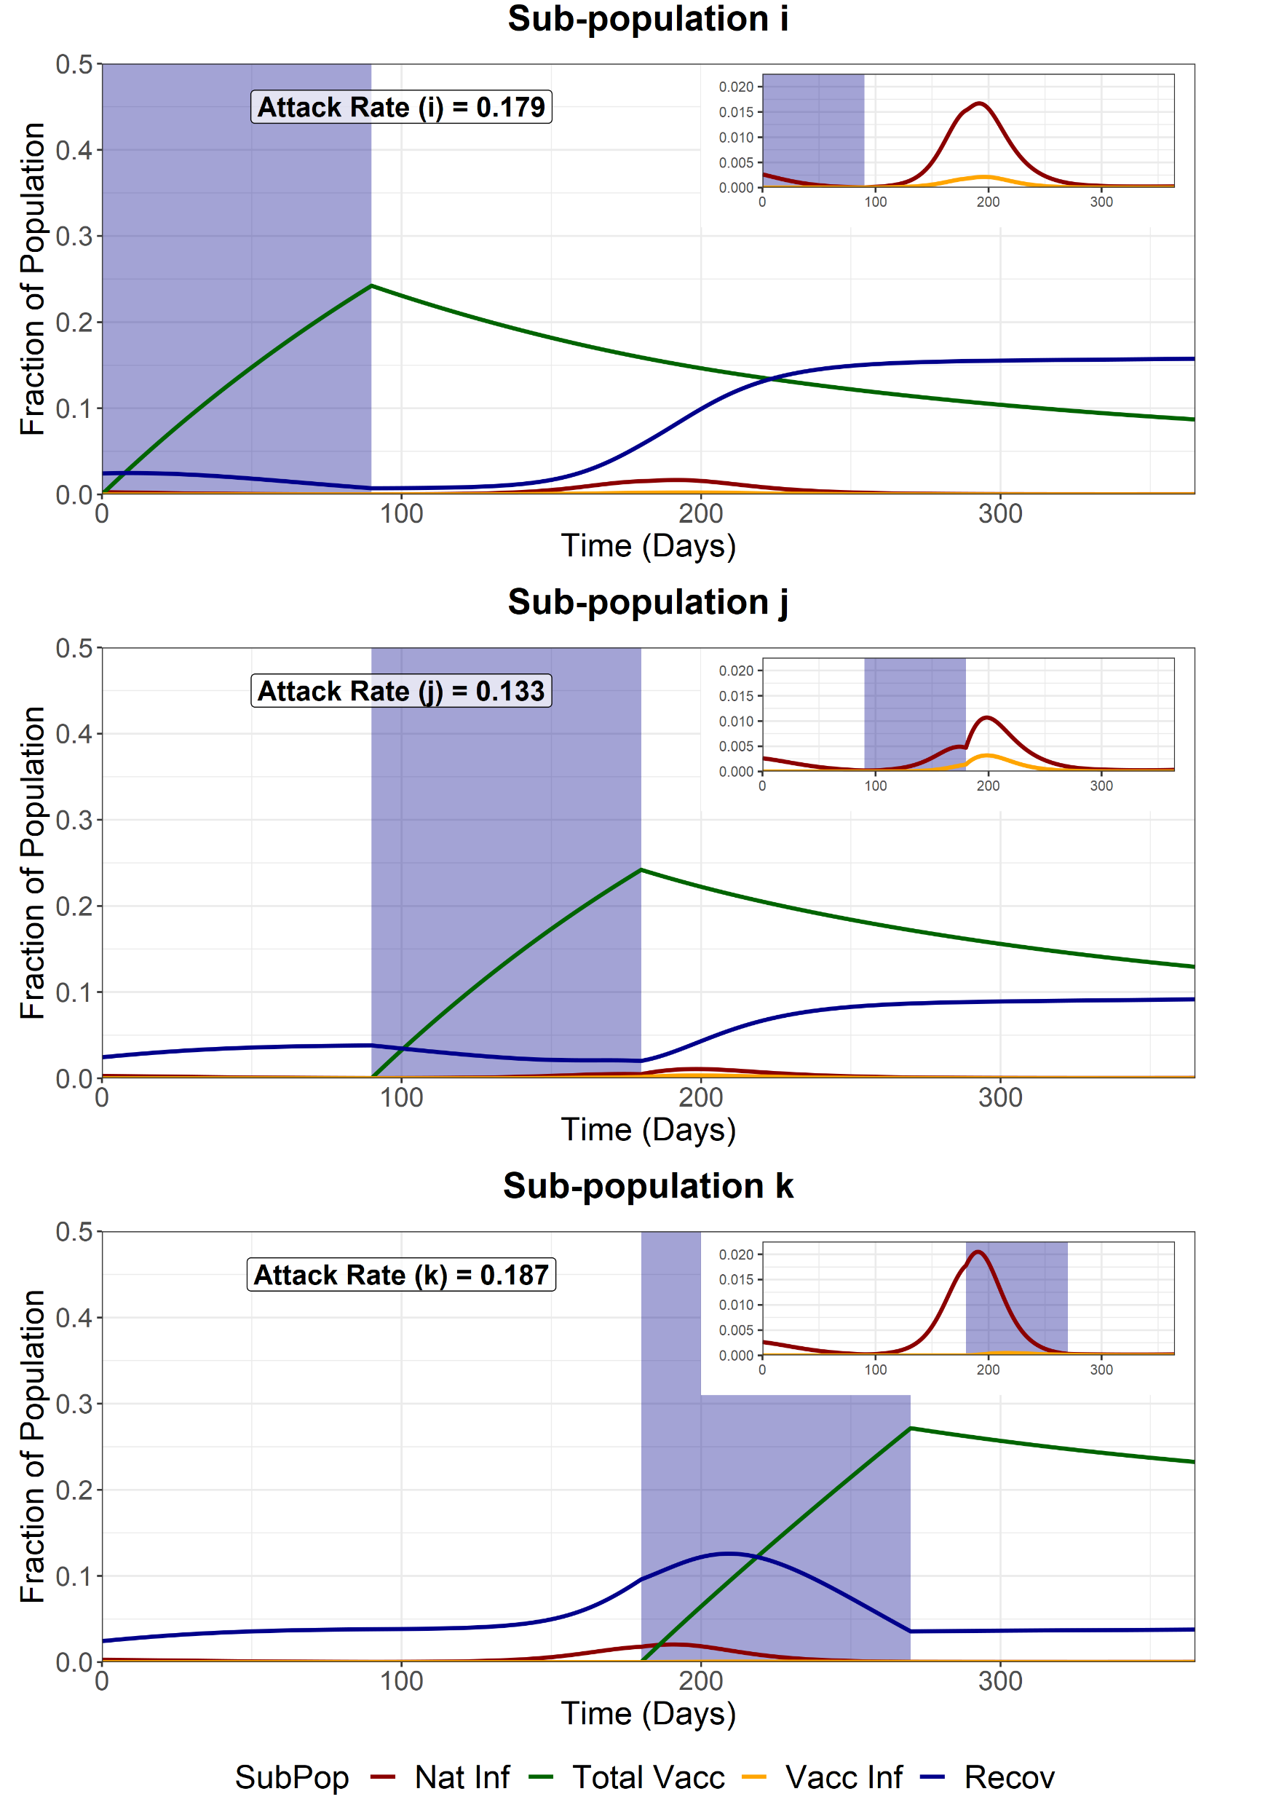
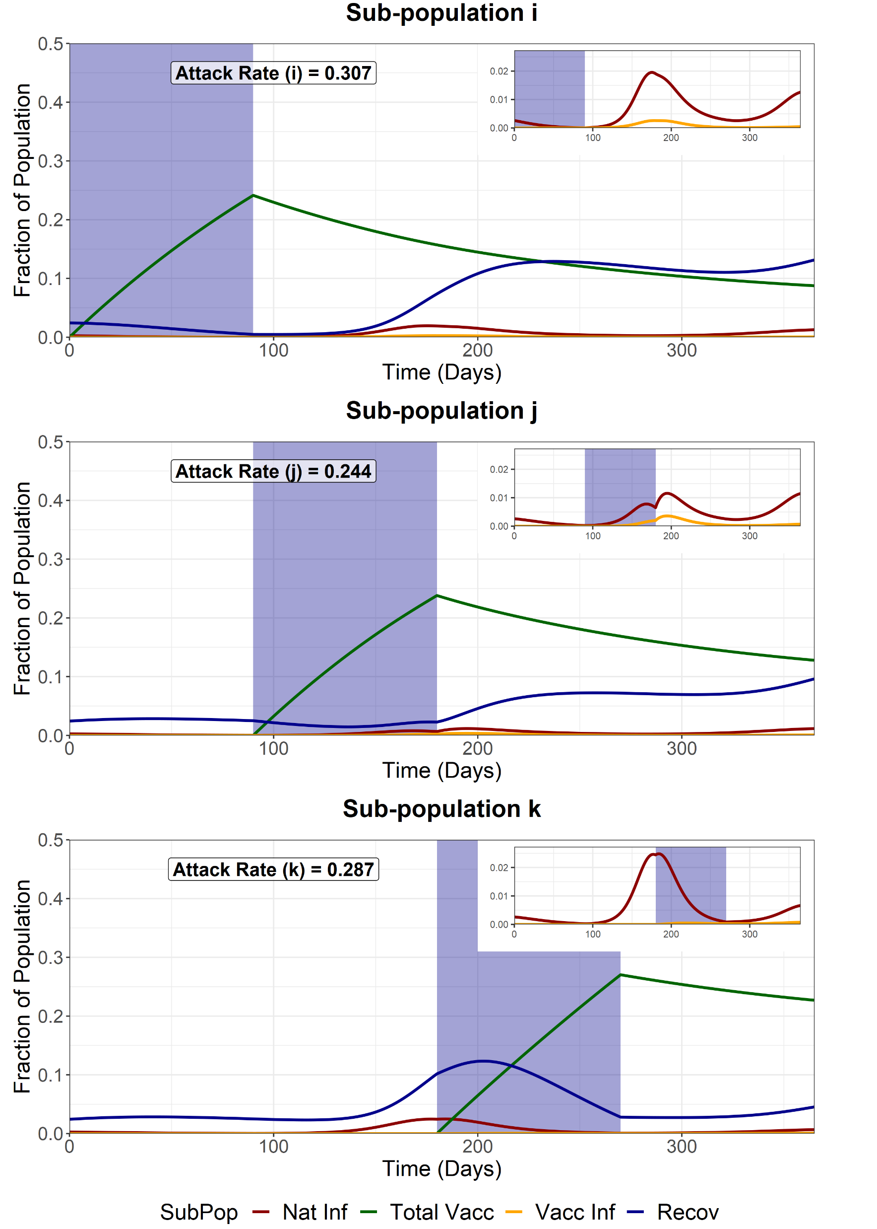
Sequential Vaccination
Each vaccination schedule lasts 90 days and aims for 90% coverage of the available S, I and R compartments at the beginning of the simulation. After vaccination of each subpopulation, the sub-population is released from NPIs, with the R increasing from 1 to 4.2. WAIFW matrix changes are the same as the baseline scenarios.
Waning Natural Immunity (σ₂ = 1/6 months⁻¹)
Waning Vaccine Immunity
(σ₁ = 1/6 months⁻¹)
Waning Natural and Vaccine Immunity
(both σ₁ = 1/6 months⁻¹ and σ₂ = 1/6 months⁻¹)
Attack Rate for fully susceptible individuals in sub-group i = 0.0088
Attack Rate for fully susceptible individuals in sub-group i = 0.159
Attack Rate for fully susceptible individuals in sub-group i = 0.2779

Slide 36
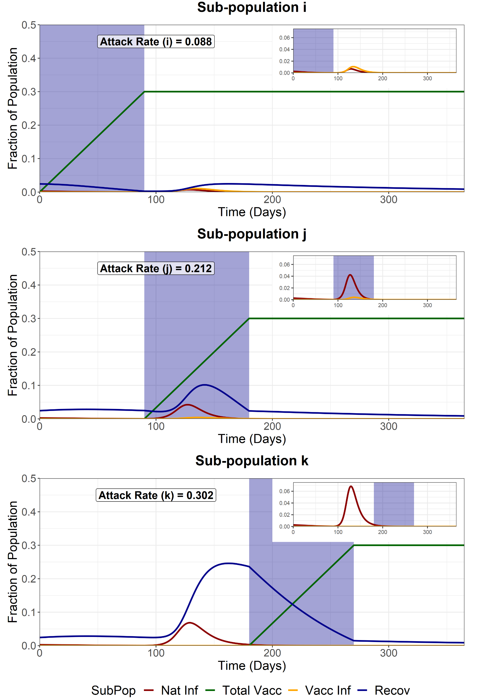
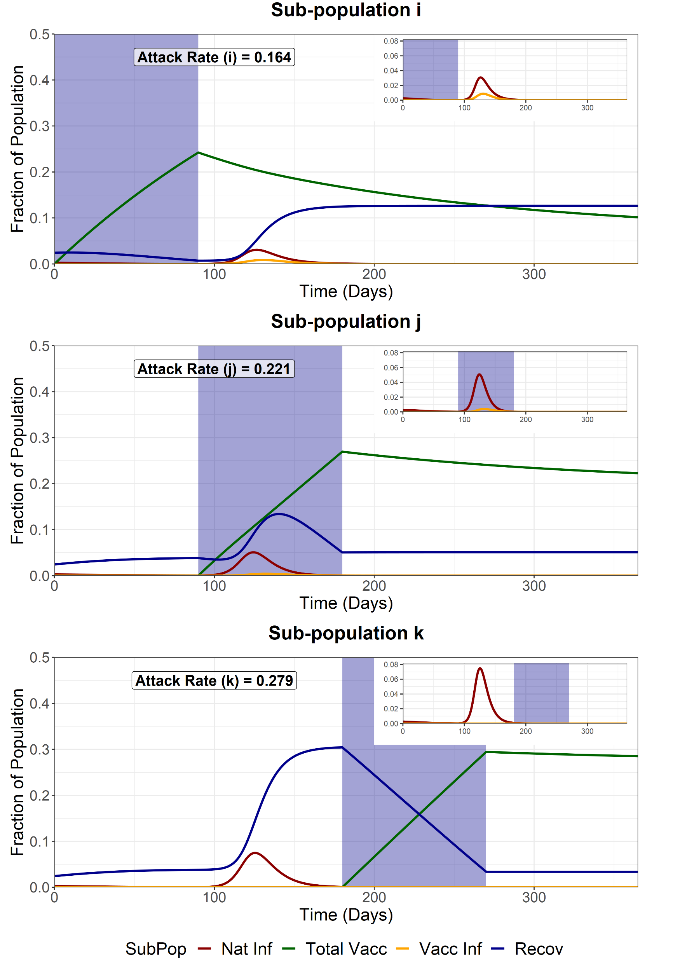
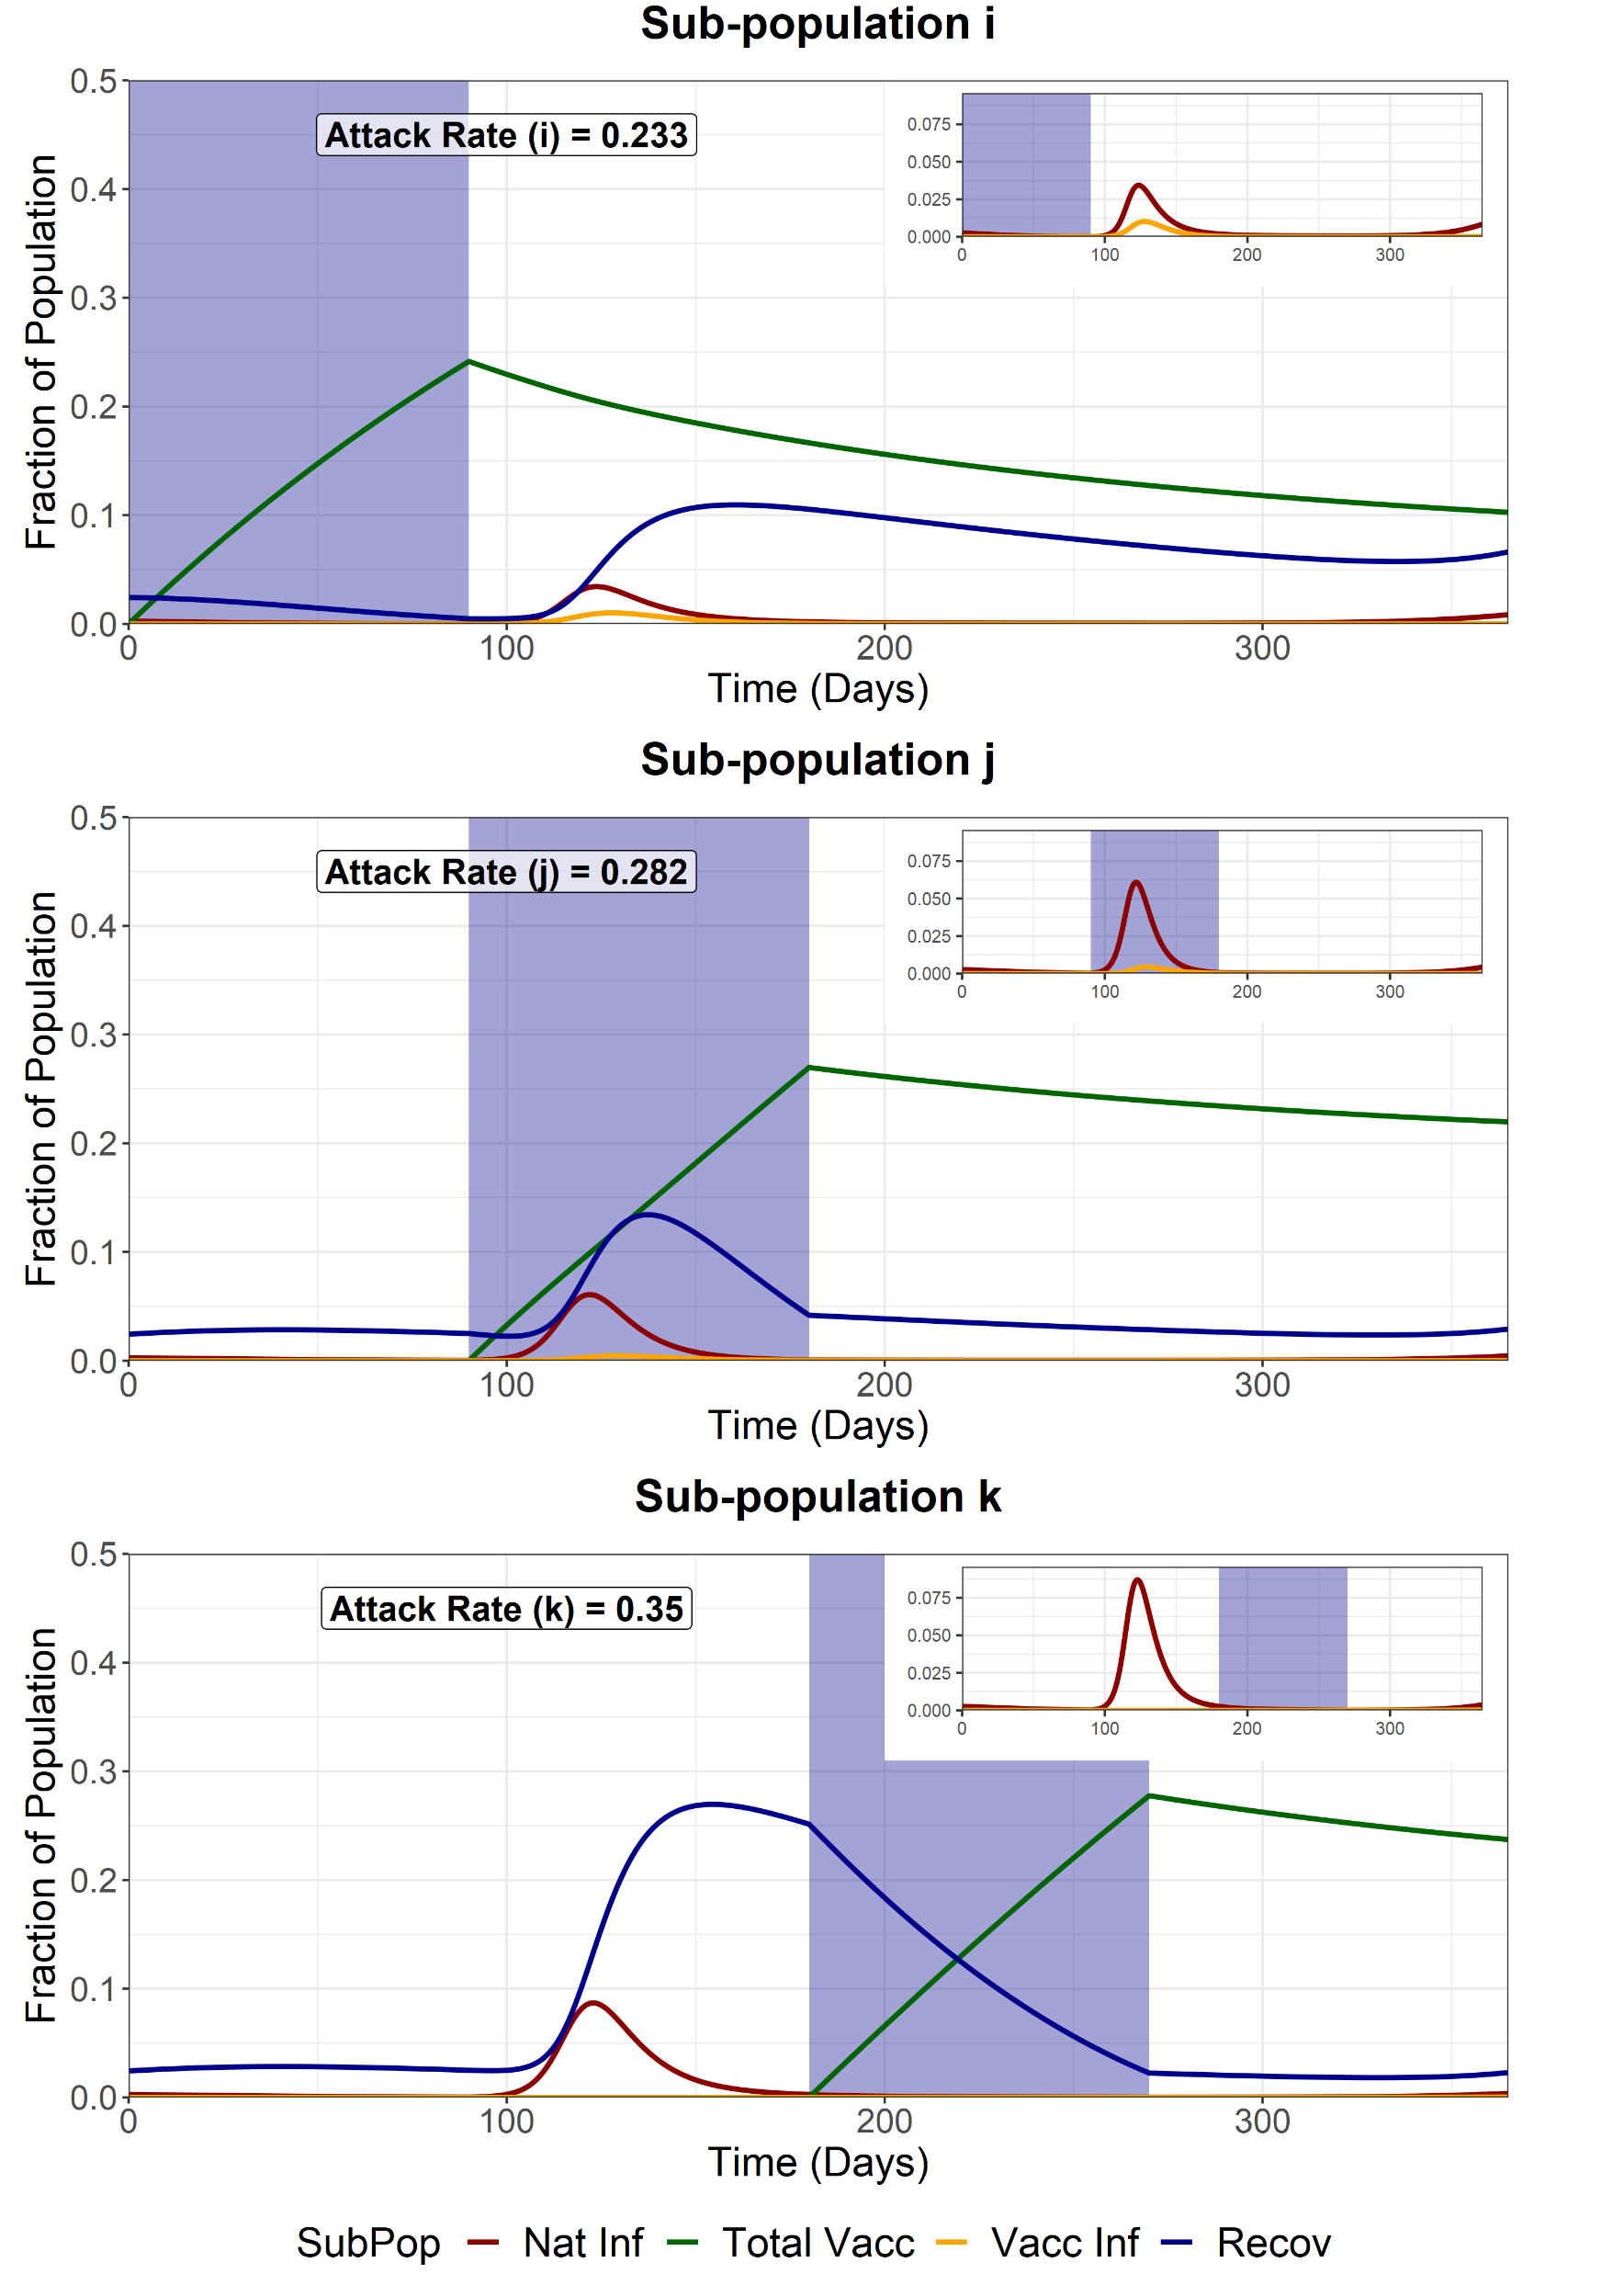
Full Release - First Group (i)
We model a full release of the entire population (i, j and k) after the vaccination of the first sub-population (i). This increases the R of the entire population from 1 to 4.2. WAIFW matrix changes are the same as the baseline scenarios.
Waning Natural Immunity (σ₂ = 1/6 months⁻¹)
Waning Vaccine Immunity
(σ₁ = 1/6 months⁻¹)
Waning Natural and Vaccine Immunity
(both σ₁ = 1/6 months⁻¹ and σ₂ = 1/6 months⁻¹)
Attack Rate for fully susceptible individuals in sub-group i = 0.0374
Attack Rate for fully susceptible individuals in sub-group i = 0.1277
Attack Rate for fully susceptible individuals in sub-group i = 0.1886

Slide 37

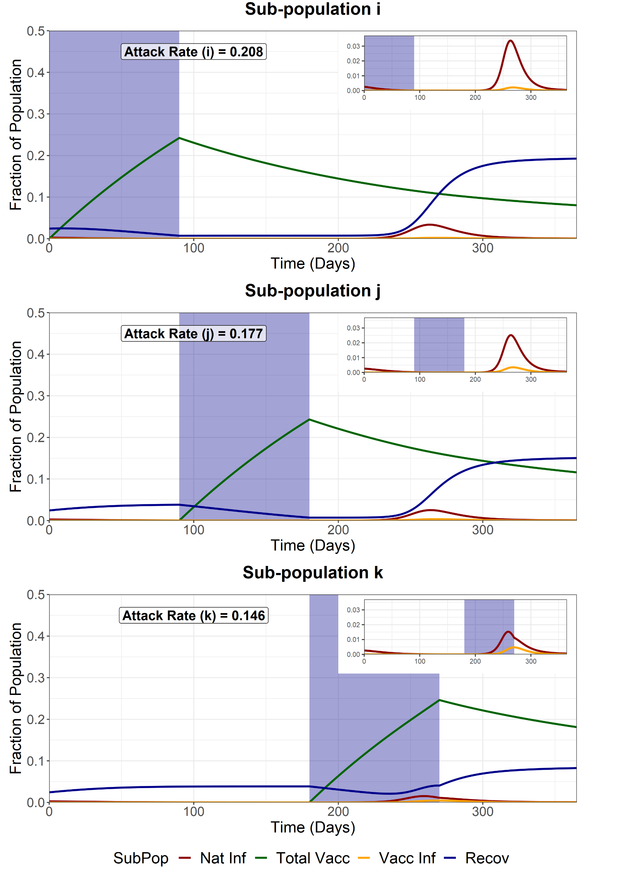
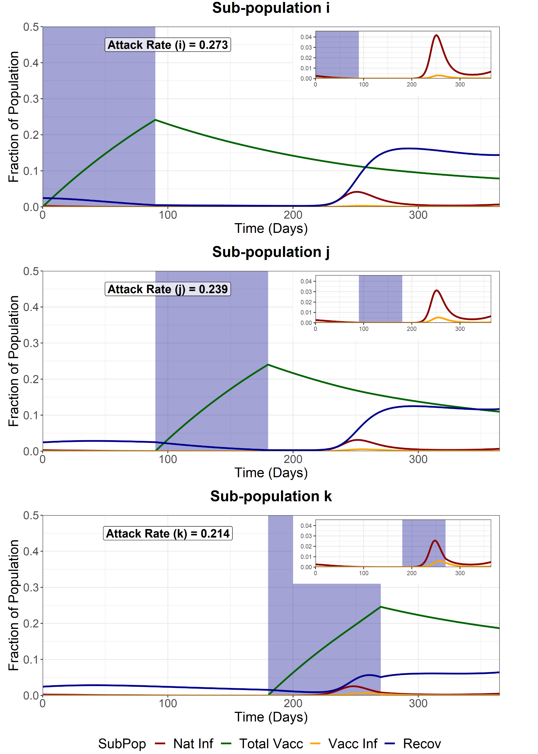
Full Release - Second Group (j)
We model a full release of the entire population (i, j and k) after the vaccination of the second sub-population (j). This increases the R of the entire population from 1 to 4.2. WAIFW matrix changes are the same as the baseline scenarios.
Waning Natural Immunity (σ₂ = 1/6 months⁻¹)
Waning Vaccine Immunity
(σ₁ = 1/6 months⁻¹)
Waning Natural and Vaccine Immunity
(both σ₁ = 1/6 months⁻¹ and σ₂ = 1/6 months⁻¹)
Attack Rate for fully susceptible individuals in sub-group i = 0.0084
Attack Rate for fully susceptible individuals in sub-group i = 0.194
Attack Rate for fully susceptible individuals in sub-group i = 0.255

Slide 38

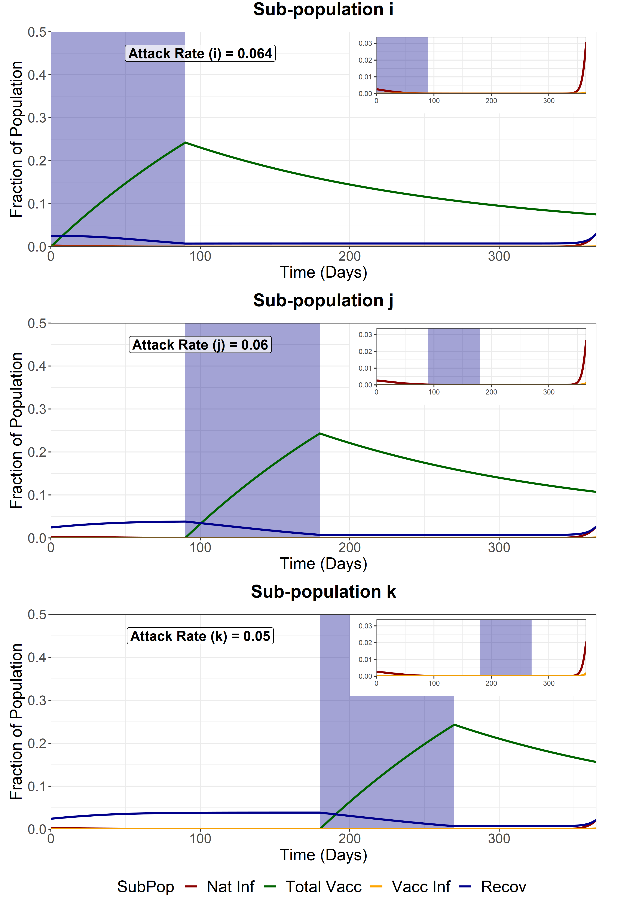
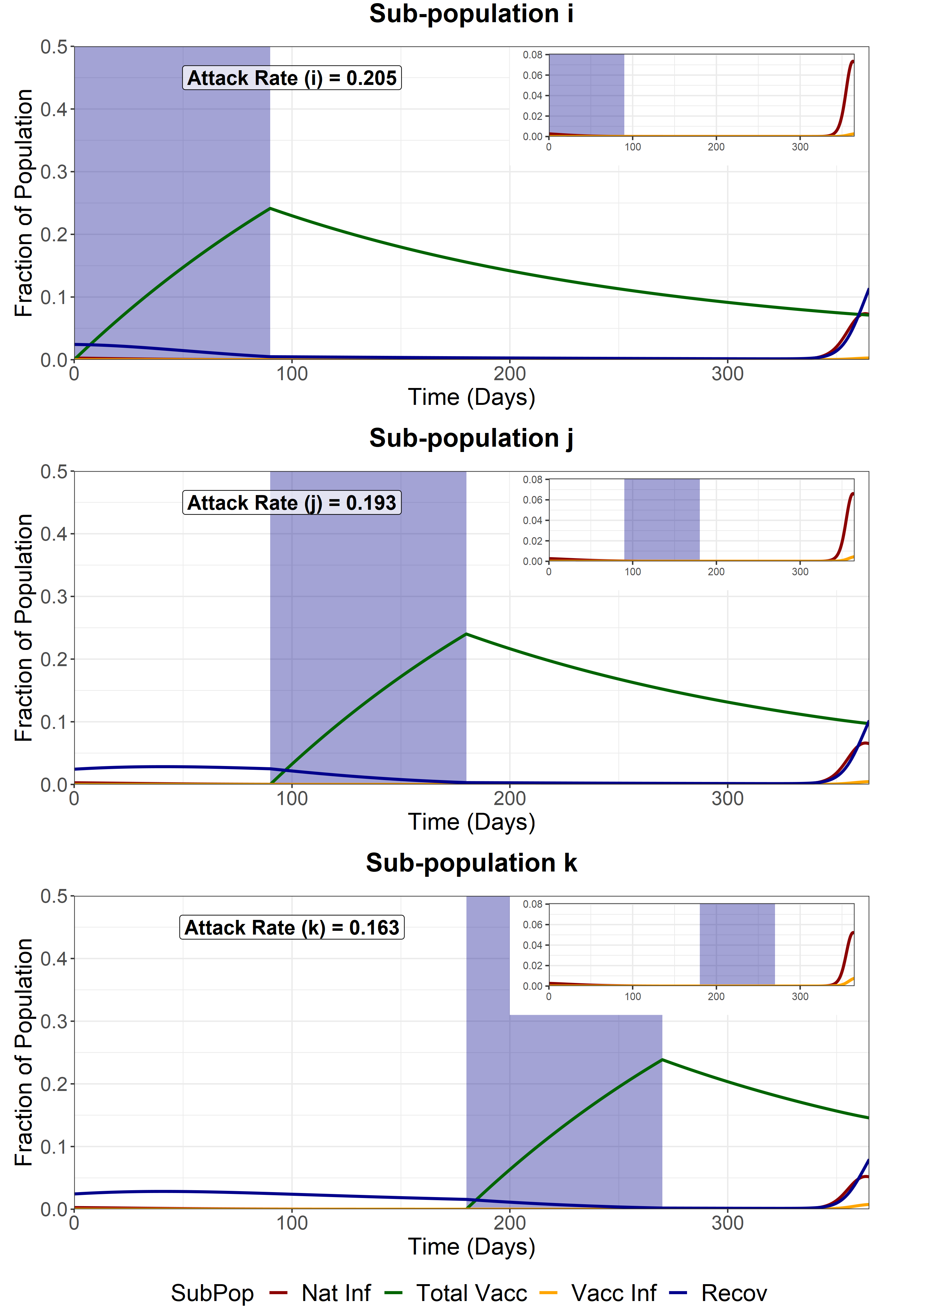
Full Release - Third Group (k)
We model a full release of the entire population (i, j and k) after the vaccination of the last sub-population (k). This increases the R of the entire population from 1 to 4.2. WAIFW matrix changes are the same as the baseline scenarios.
Waning Natural Immunity (σ₂ = 1/6 months⁻¹)
Waning Vaccine Immunity
(σ₁ = 1/6 months⁻¹)
Waning Natural and Vaccine Immunity
(both σ₁ = 1/6 months⁻¹ and σ₂ = 1/6 months⁻¹)
Attack Rate for fully susceptible individuals in sub-group i = 0.0084
Attack Rate for fully susceptible individuals in sub-group i = 0.0621
Attack Rate for fully susceptible individuals in sub-group i = 0.19897

Slide 39
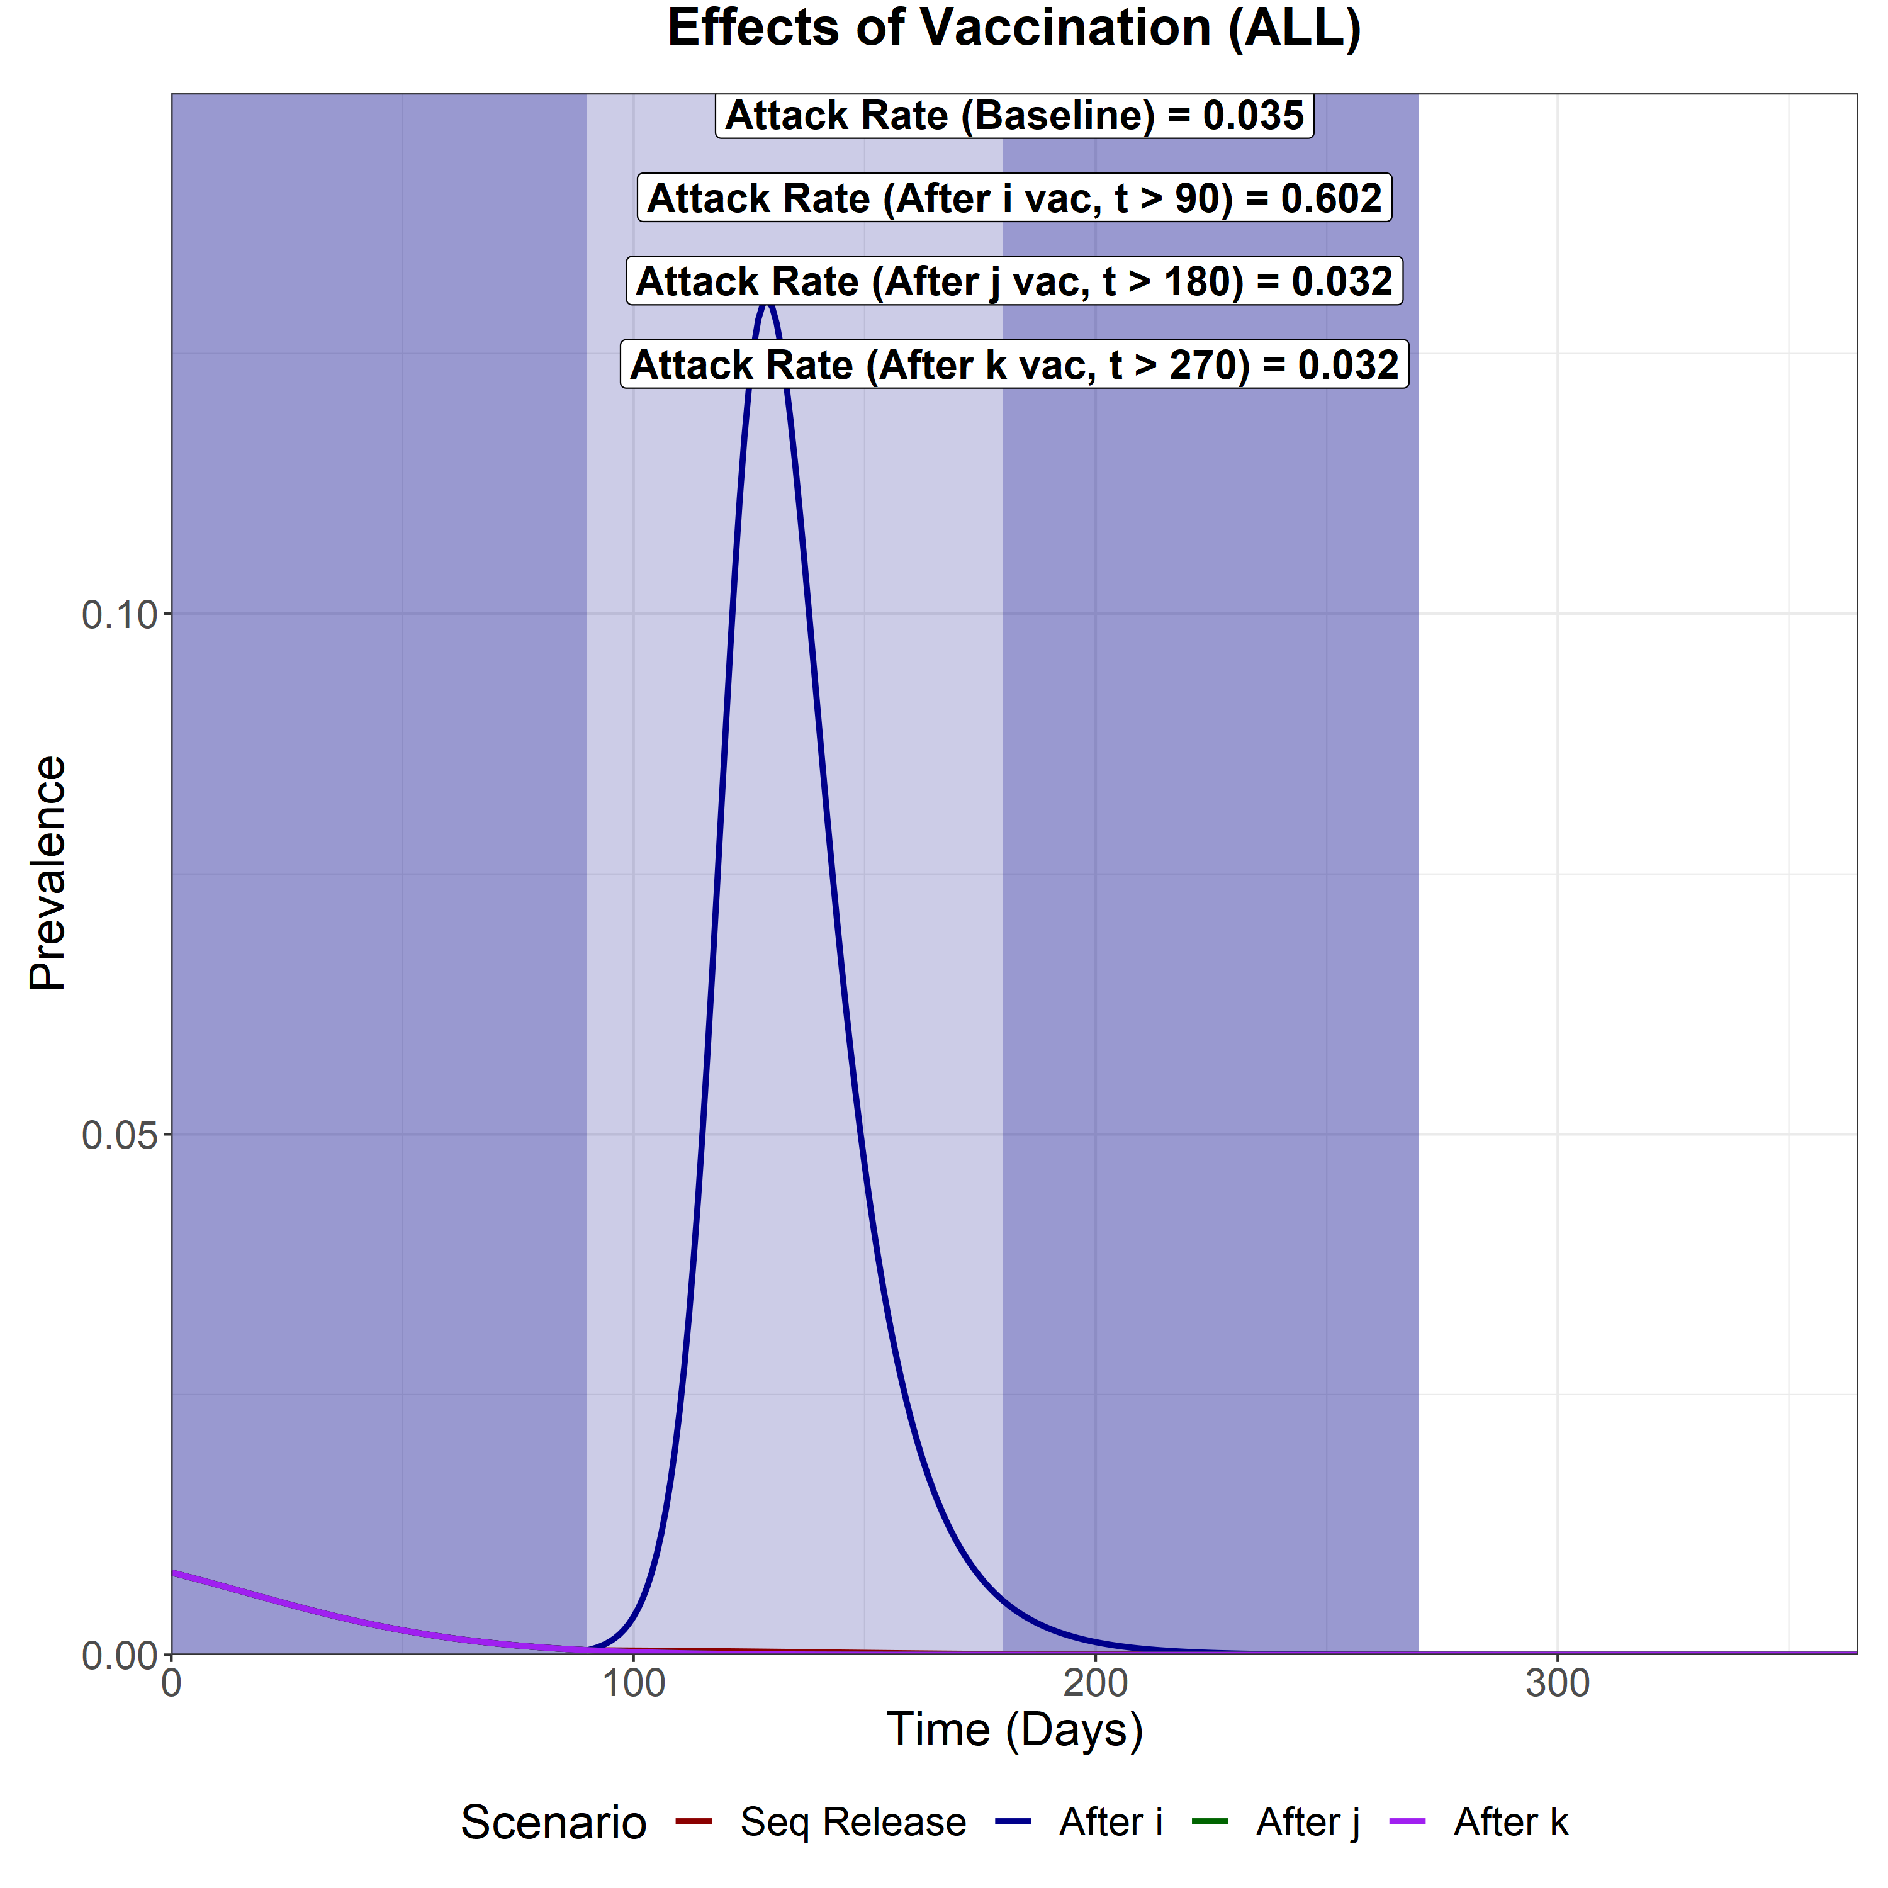
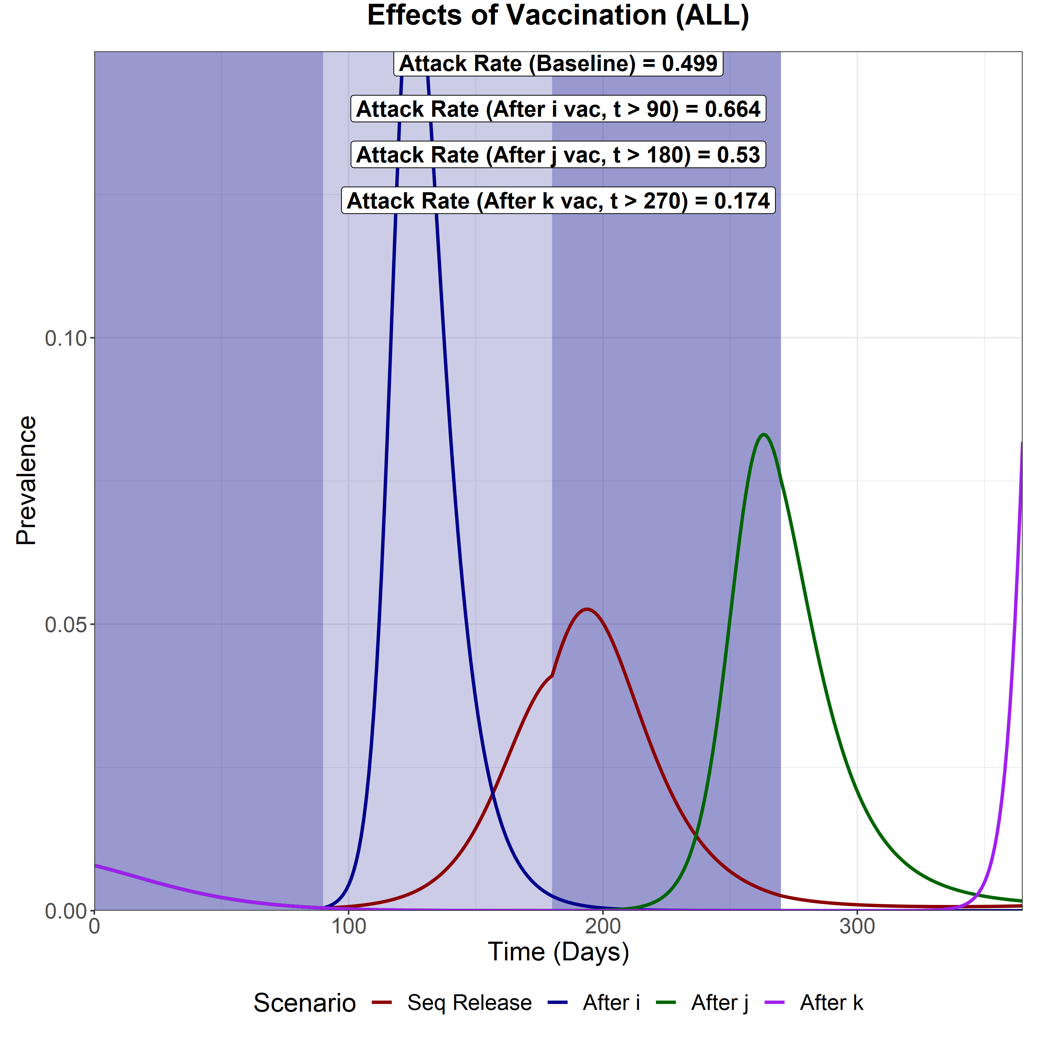
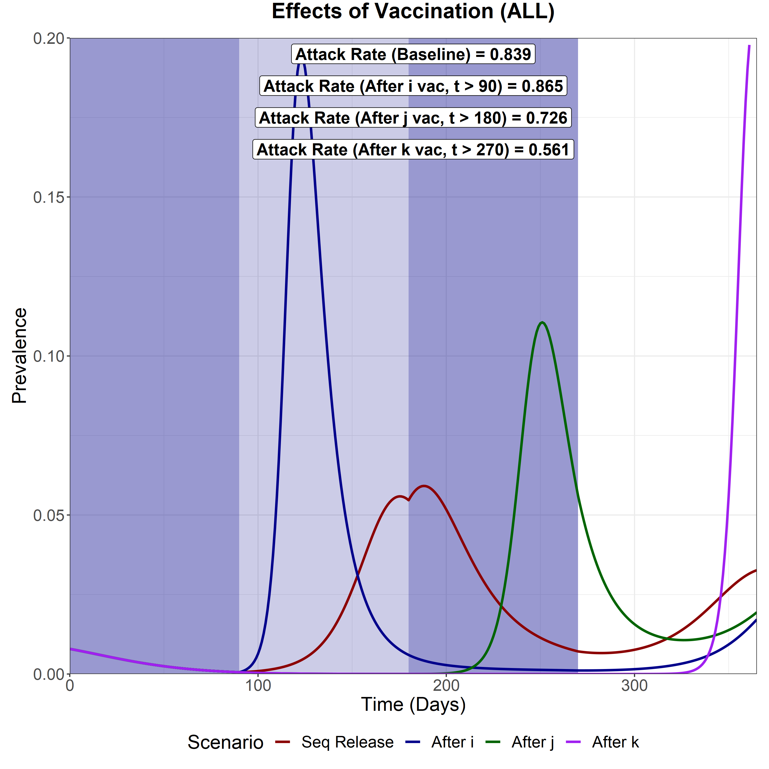
Waning Natural Immunity
(σ₂ = 1/6 months⁻¹)
Waning Vaccine Immunity
(σ₁ = 1/6 months⁻¹)
Waning Natural and Vaccine Immunity
(both σ₁ = 1/6 months⁻¹ and σ₂ = 1/6 months⁻¹)
Sequential Vaccination
Attack Rate (i) – 0.009
Attack Rate (j) – 0.012
Attack Rate (k) - 0.013
Attack Rate for fully susceptibles in i - 0.0088
Full Release after i vacc
Attack Rate (i) – 0.088
Attack Rate (j) – 0.212
Attack Rate (k) – 0.302
Attack Rate for fully susceptibles in i - 0.0374
Full Release after j vacc
Attack Rate (i) – 0.009
Attack Rate (j) – 0.012
Attack Rate (k) – 0.012
Attack Rate for fully susceptibles in i - 0.0084
Full Release after k vacc
Attack Rate (i) – 0.009
Attack Rate (j) – 0.012
Attack Rate (k) – 0.012
Attack Rate for fully susceptibles in i - 0.0084
Sequential Vaccination
Attack Rate (i) – 0.179
Attack Rate (j) – 0.133
Attack Rate (k) – 0.187
Attack Rate for fully susceptibles in i - 0.159
Full Release after i vacc
Attack Rate (i) – 0.164
Attack Rate (j) – 0.221
Attack Rate (k) – 0.279
Attack Rate for fully susceptibles in i - 0.1277
Full Release after j vacc
Attack Rate (i) – 0.208
Attack Rate (j) – 0.177
Attack Rate (k) – 0.146
Attack Rate for fully susceptibles in i - 0.194
Full Release after k vacc
Attack Rate (i) – 0.064
Attack Rate (j) – 0.06
Attack Rate (k) – 0.05
Attack Rate for fully susceptibles in i - 0.0621
Sequential Vaccination
Attack Rate (i) – 0.307
Attack Rate (j) – 0.244
Attack Rate (k) – 0.287
Attack Rate for fully susceptibles in i - 0.2779
Full Release after i vacc
Attack Rate (i) – 0.233
Attack Rate (j) – 0.282
Attack Rate (k) – 0.35
Attack Rate for fully susceptibles in i - 0.1886
Full Release after j vacc
Attack Rate (i) – 0.273
Attack Rate (j) – 0.239
Attack Rate (k) – 0.214
Attack Rate for fully susceptibles in i - 0.255
Full Release after k vacc
Attack Rate (i) – 0.205
Attack Rate (j) – 0.193
Attack Rate (k) – 0.163
Attack Rate for fully susceptibles in i - 0.19897

Slide 40
VACCINE INDUCED BLOCKING OF COVID-19 TRANSMISSION
We model varying levels of vaccine induced transmission blocking. We model variations in reductions to vaccinated individuals becoming infected (e_{ff1}) and transmission from vaccinated individuals (e_{ff2}).
We model 3 levels of transmission blocking: 50%, 75% and 90% (baseline).

Slide 41
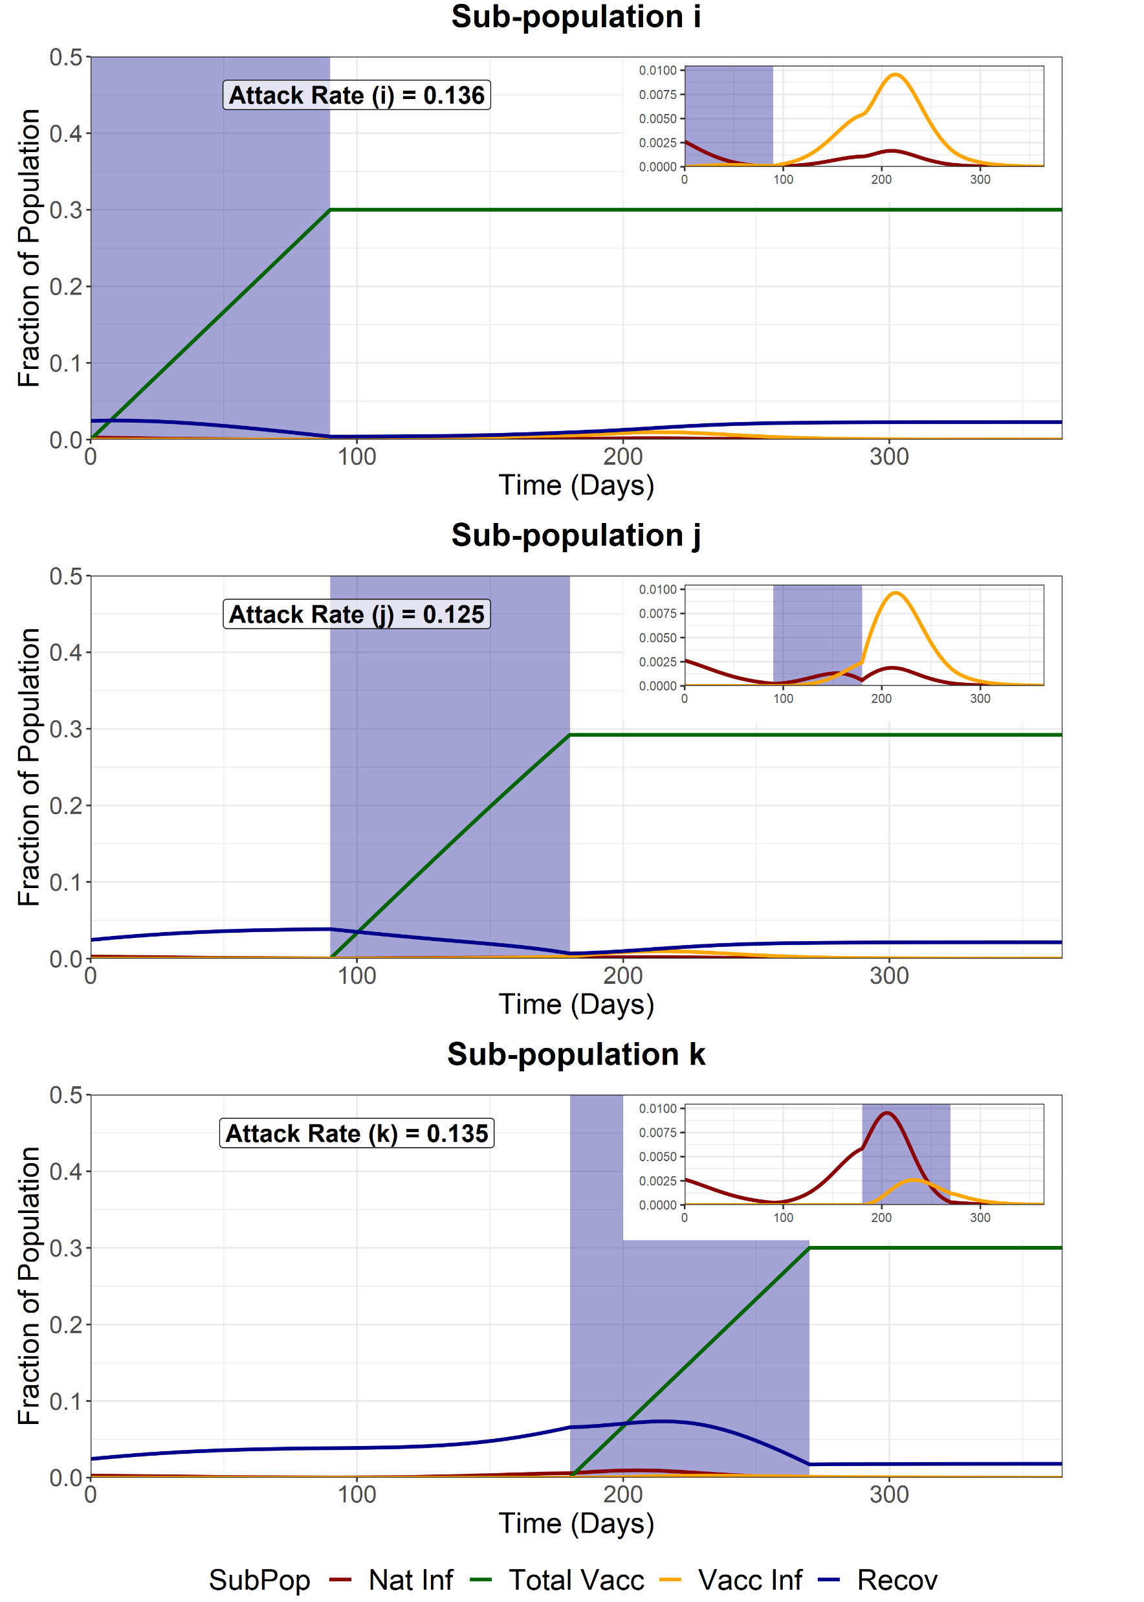

Sequential Vaccination
We model sequential vaccination of 3 sub-populations. Each vaccination schedule lasts 90 days and aims for 90% coverage of the available susceptibles, infecteds and recovereds at the beginning of the simulation. After vaccination of each subpopulation, the sub-population is released from NPIs, with the R increasing from 1 to 4.2. WAIFW matrix changes are the same as the baseline scenarios.
Transmission Blocking: 50%
(e_{ff1} and e_{ff2} = 0.5)
Transmission Blocking: 75%
(e_{ff1} and e_{ff2} = 0.75)
Transmission Blocking: 90%
(e_{ff1} and e_{ff2} = 0.9)
Attack Rate for fully susceptible individuals in sub-group i = 0.027
Attack Rate for fully susceptible individuals in sub-group i = 0.0087
Attack Rate for fully susceptible individuals in sub-group i = 0.0084

Slide 42

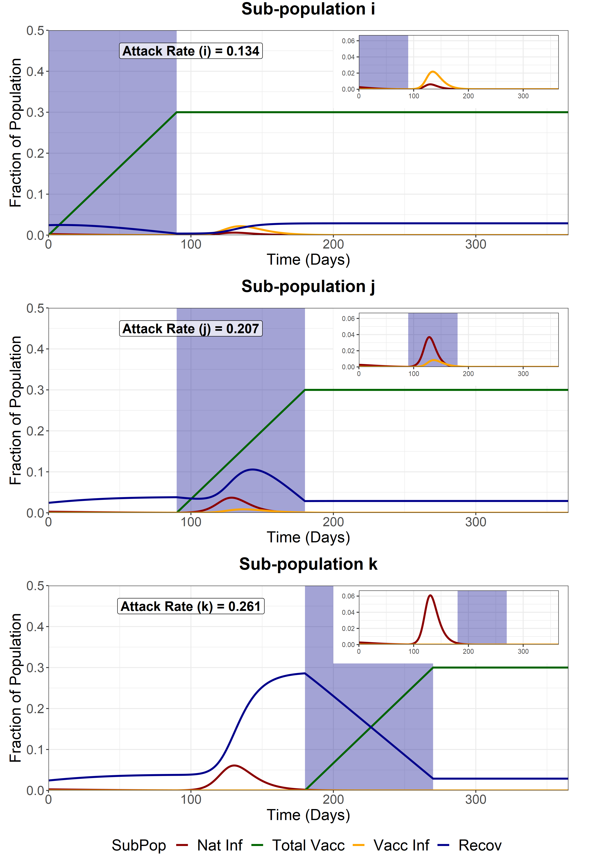

Full Release - First Group (i)
We model a full release of the entire population (i, j and k) after the vaccination of the first sub-population (i). This increases the R of the entire population from 1 to 4.2. WAIFW matrix changes are the same as the baseline scenarios.
Transmission Blocking: 50%
(e_{ff1} and e_{ff2} = 0.5)
Transmission Blocking: 75%
(e_{ff1} and e_{ff2} = 0.75)
Transmission Blocking: 90%
(e_{ff1} and e_{ff2} = 0.9)
Attack Rate for fully susceptible individuals in sub-group i = 0.035
Attack Rate for fully susceptible individuals in sub-group i = 0.0332
Attack Rate for fully susceptible individuals in sub-group i = 0.032

Slide 43
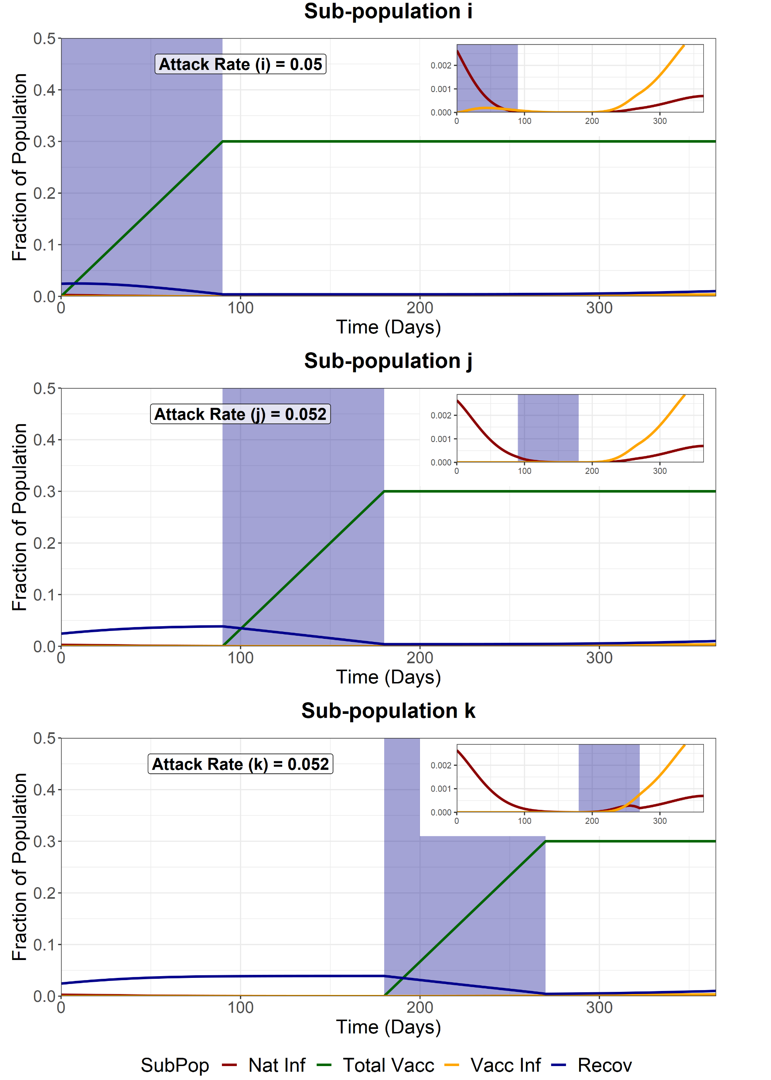

Full Release - Second Group (j)
We model a full release of the entire population (i, j and k) after the vaccination of the second sub-population (j). This increases the R of the entire population from 1 to 4.2. WAIFW matrix changes are the same as the baseline scenarios.
Transmission Blocking: 50%
(e_{ff1} and e_{ff2} = 0.5)
Transmission Blocking: 75%
(e_{ff1} and e_{ff2} = 0.75)
Transmission Blocking: 90%
(e_{ff1} and e_{ff2} = 0.9)
Attack Rate for fully susceptible individuals in sub-group i = 0.0152
Attack Rate for fully susceptible individuals in sub-group i = 0.0083
Attack Rate for fully susceptible individuals in sub-group i = 0.0082

Slide 44
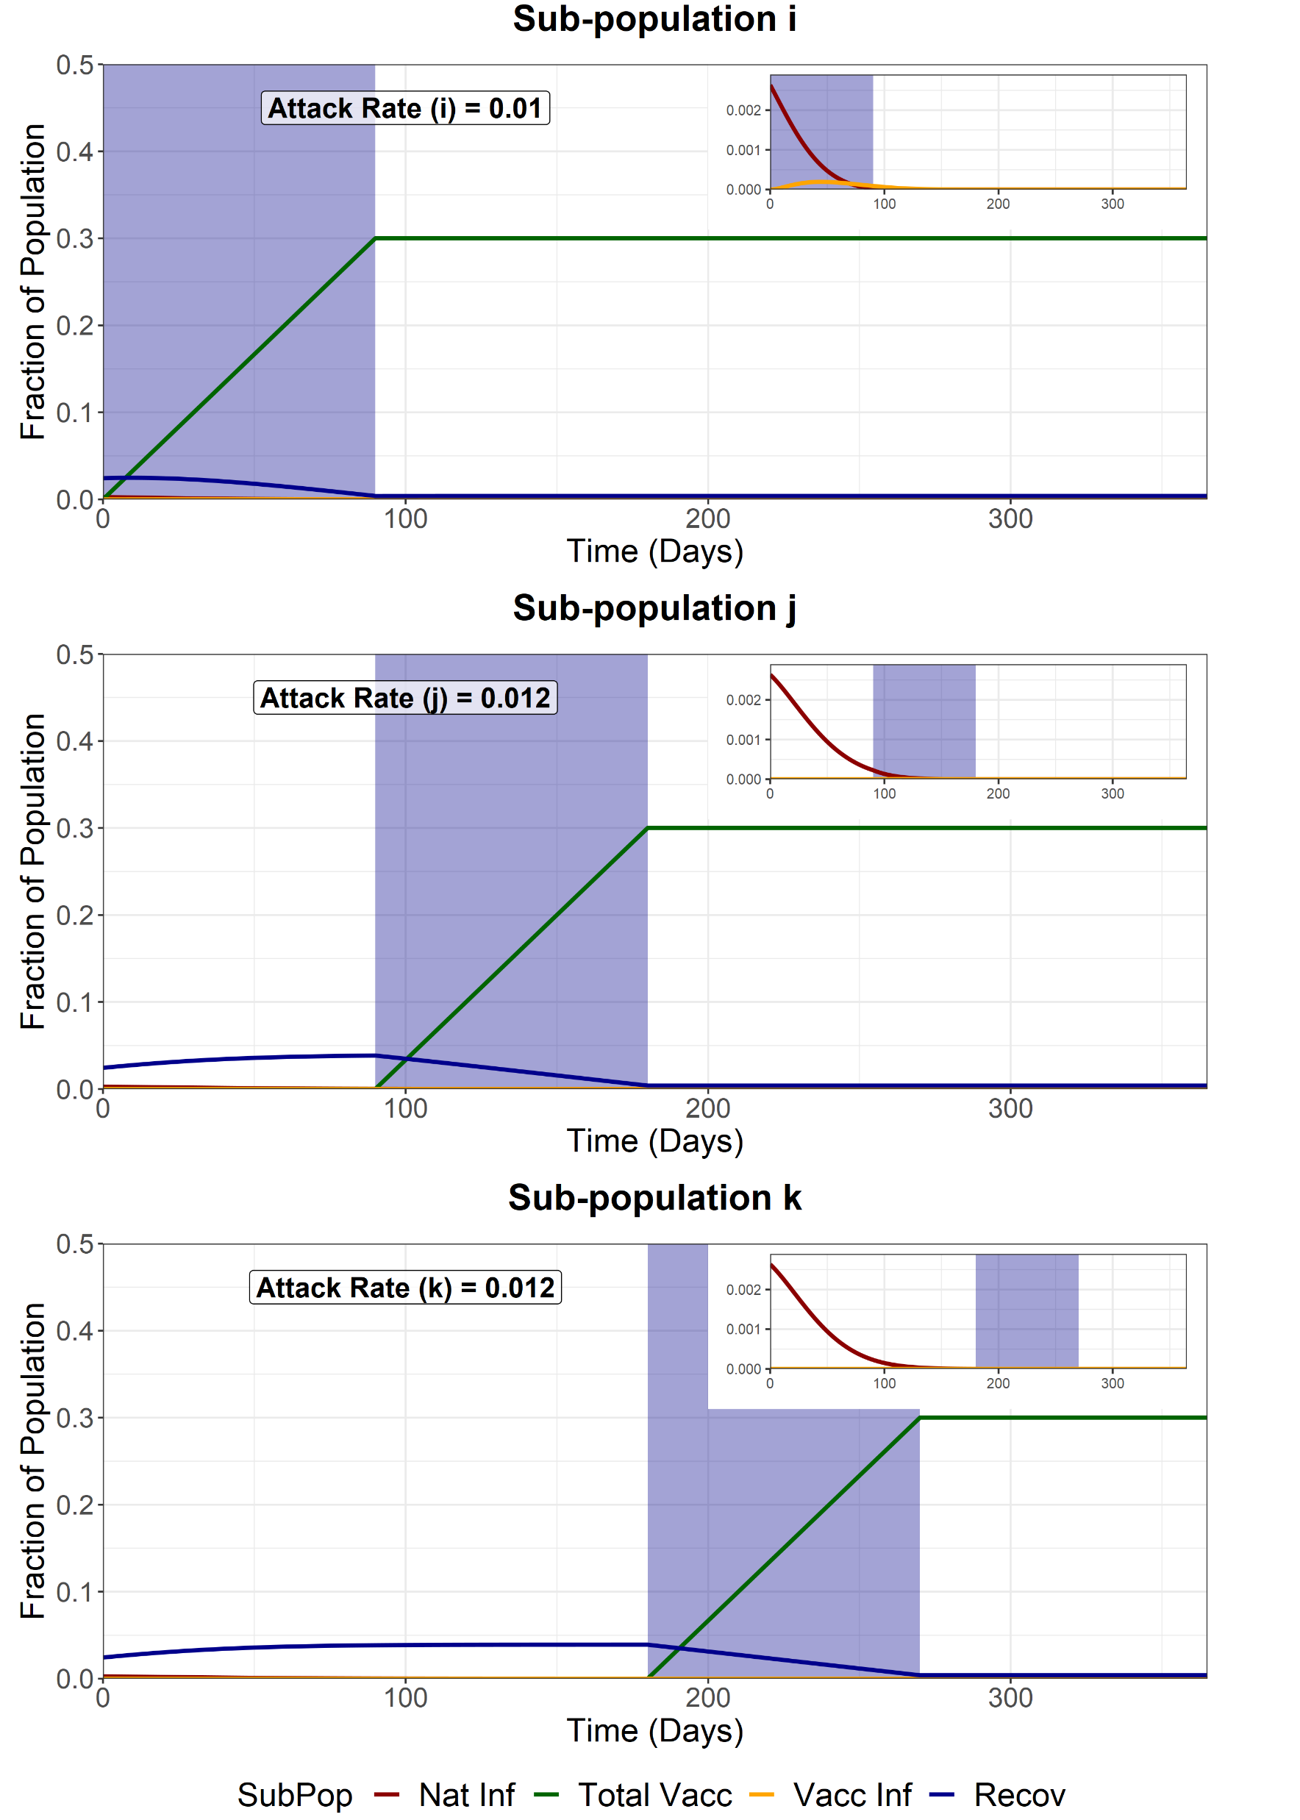

Full Release - Third Group (k)
We model a full release of the entire population (i, j and k) after the vaccination of the last sub-population (k). This increases the R of the entire population from 1 to 4.2. WAIFW matrix changes are the same as the baseline scenarios.
Transmission Blocking: 50%
(e_{ff1} and e_{ff2} = 0.5)
Transmission Blocking: 75%
(e_{ff1} and e_{ff2} = 0.75)
Transmission Blocking: 90%
(e_{ff1} and e_{ff2} = 0.9)
Attack Rate for fully susceptible individuals in sub-group i = 0.0085
Attack Rate for fully susceptible individuals in sub-group i = 0.0082
Attack Rate for fully susceptible individuals in sub-group i = 0.0082

Slide 45
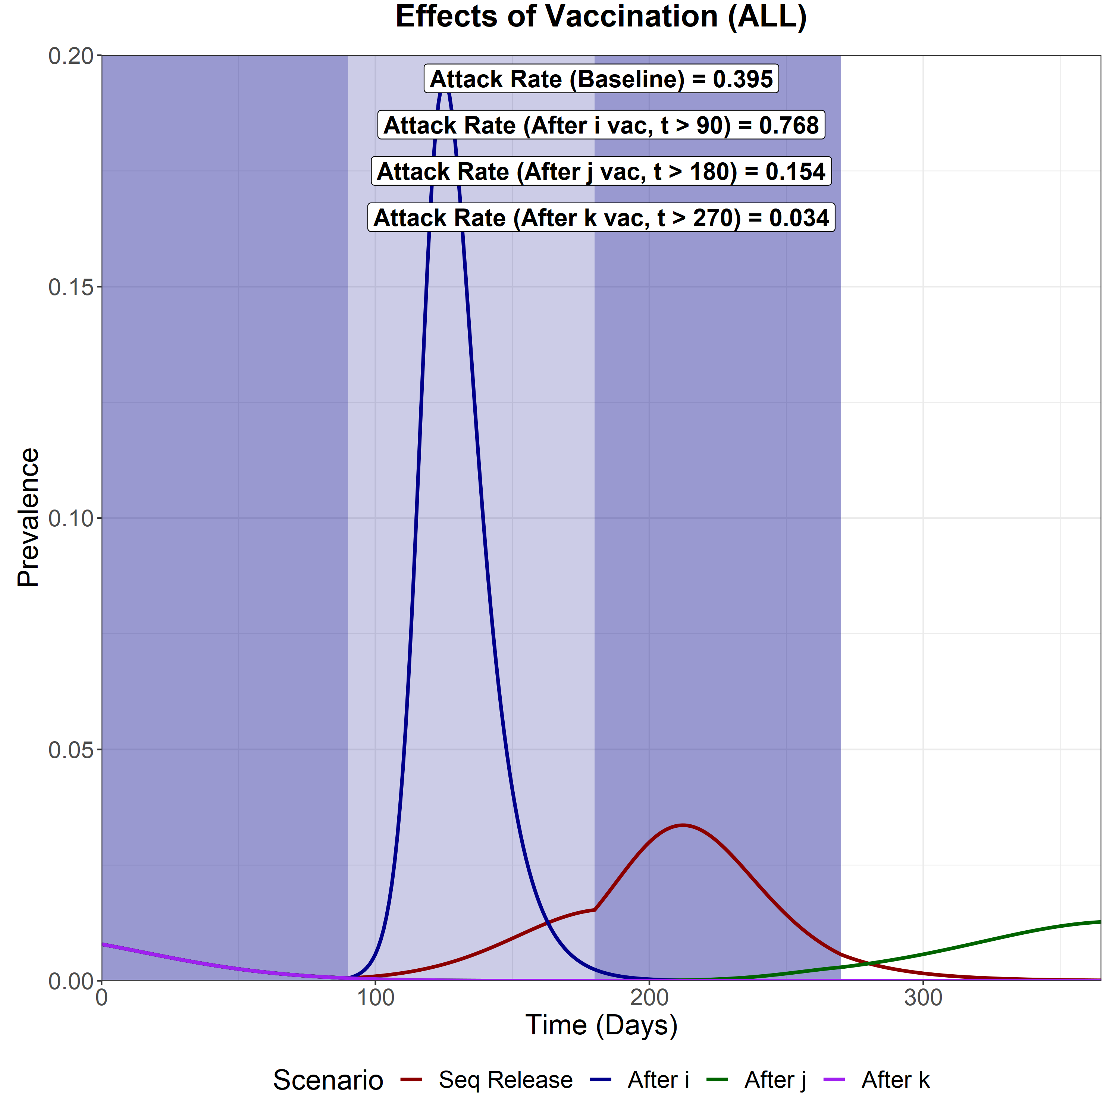

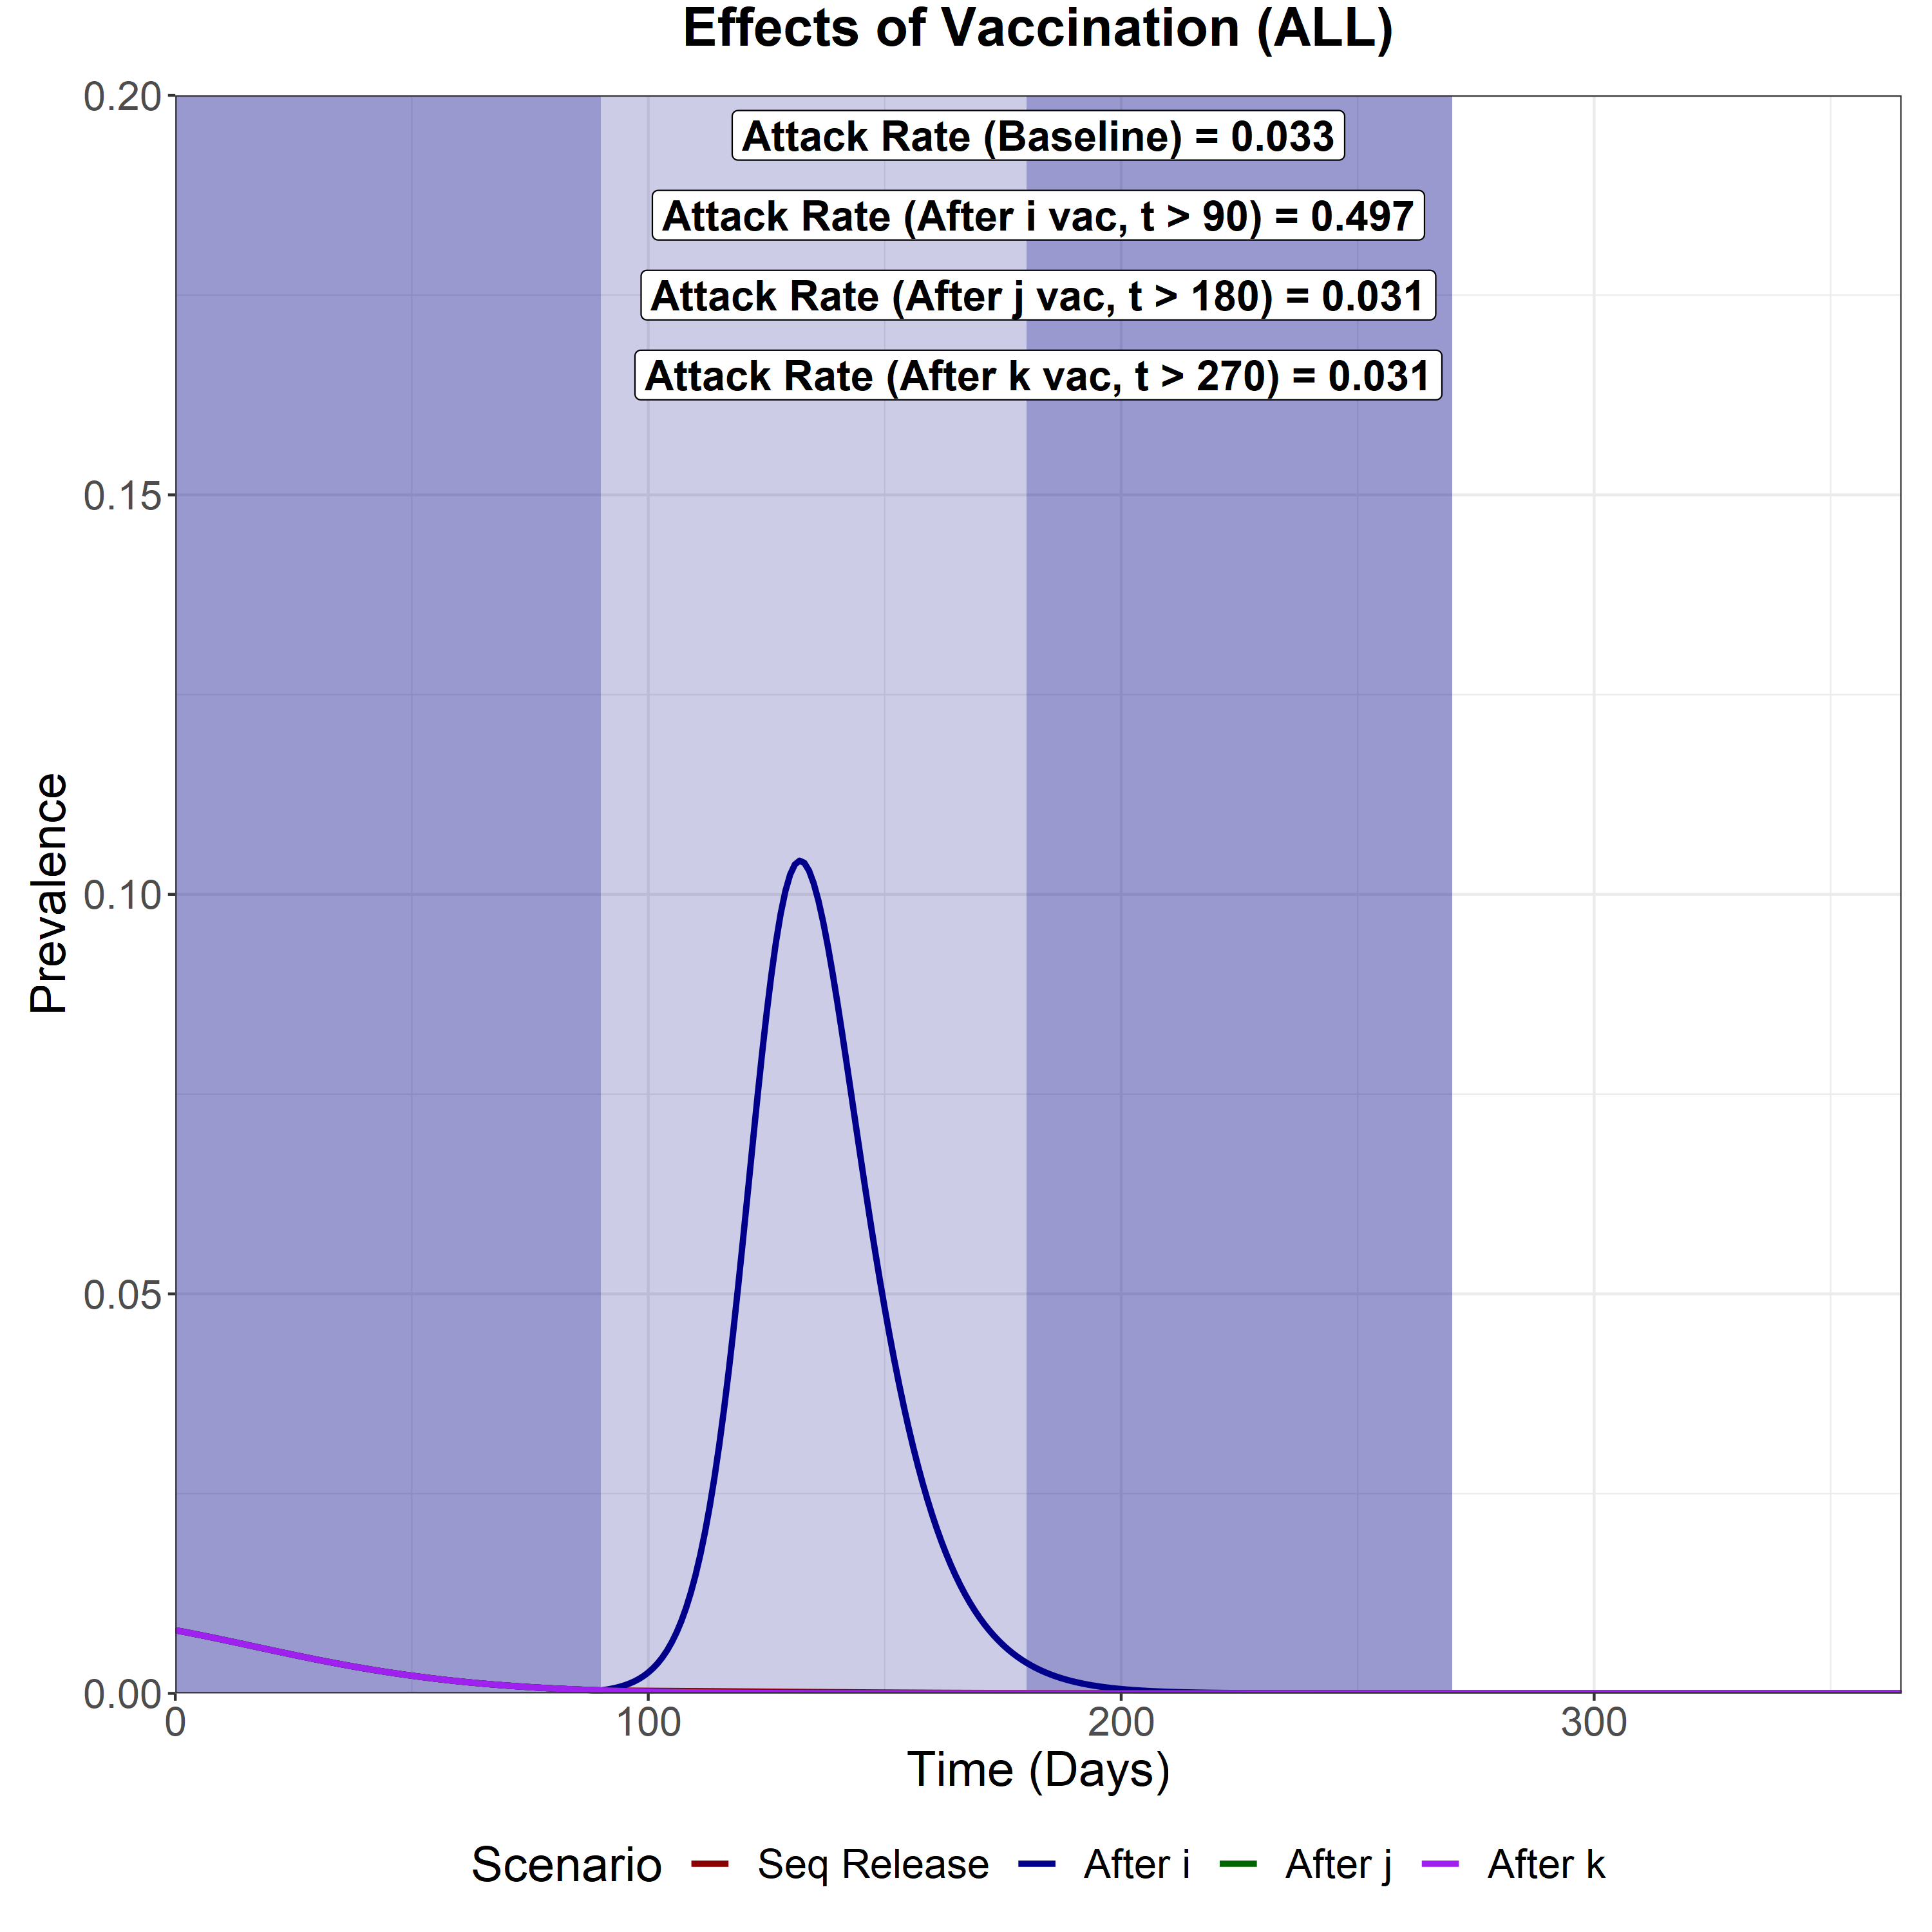
Transmission Blocking: 50%
(e_{ff1} and e_{ff2} = 0.5)
Transmission Blocking: 75%
(e_{ff1} and e_{ff2} = 0.75)
Transmission Blocking: 90%
(e_{ff1} and e_{ff2} = 0.9)
Sequential Vaccination
Attack Rate (i) – 0.136
Attack Rate (j) – 0.125
Attack Rate (k) – 0.135
Attack Rate for fully susceptibles in i - 0.027
Full Release after i vacc
Attack Rate (i) – 0.226
Attack Rate (j) – 0.26
Attack Rate (k) – 0.281
Attack Rate for fully susceptibles in i - 0.035
Full Release after j vacc
Attack Rate (i) – 0.05
Attack Rate (j) – 0.052
Attack Rate (k) – 0.052
Attack Rate for fully susceptibles in i - 0.0152
Full Release after k vacc
Attack Rate (i) – 0.01
Attack Rate (j) – 0.012
Attack Rate (k) – 0.012
Attack Rate for fully susceptibles in i - 0.0085
Sequential Vaccination
Attack Rate (i) – 0.011
Attack Rate (j) – 0.013
Attack Rate (k) – 0.013
Attack Rate for fully susceptibles in i - 0.0087
Full Release after i vacc
Attack Rate (i) – 0.134
Attack Rate (j) – 0.207
Attack Rate (k) – 0.261
Attack Rate for fully susceptibles in i - 0.0332
Full Release after j vacc
Attack Rate (i) – 0.009
Attack Rate (j) – 0.011
Attack Rate (k) – 0.011
Attack Rate for fully susceptibles in i - 0.0083
Full Release after k vacc
Attack Rate (i) – 0.009
Attack Rate (j) – 0.011
Attack Rate (k) – 0.011
Attack Rate for fully susceptibles in i - 0.0082
Sequential Vaccination
Attack Rate (i) – 0.009
Attack Rate (j) – 0.012
Attack Rate (k) – 0.012
Attack Rate for fully susceptibles in i - 0.0084
Full Release after i vacc
Attack Rate (i) – 0.074
Attack Rate (j) – 0.173
Attack Rate (k) – 0.25
Attack Rate for fully susceptibles in i - 0.032
Full Release after j vacc
Attack Rate (i) – 0.009
Attack Rate (j) – 0.011
Attack Rate (k) – 0.011
Attack Rate for fully susceptibles in i - 0.0082
Full Release after k vacc
Attack Rate (i) – 0.009
Attack Rate (j) – 0.011
Attack Rate (k) – 0.011
Attack Rate for fully susceptibles in i - 0.0082

Slide 46
SENSITIVITY TO VACCINE COVERAGE
We model varying levels of vaccine coverage. Coverage is varied from 90% (baseline), 70% to 50%.

Slide 47
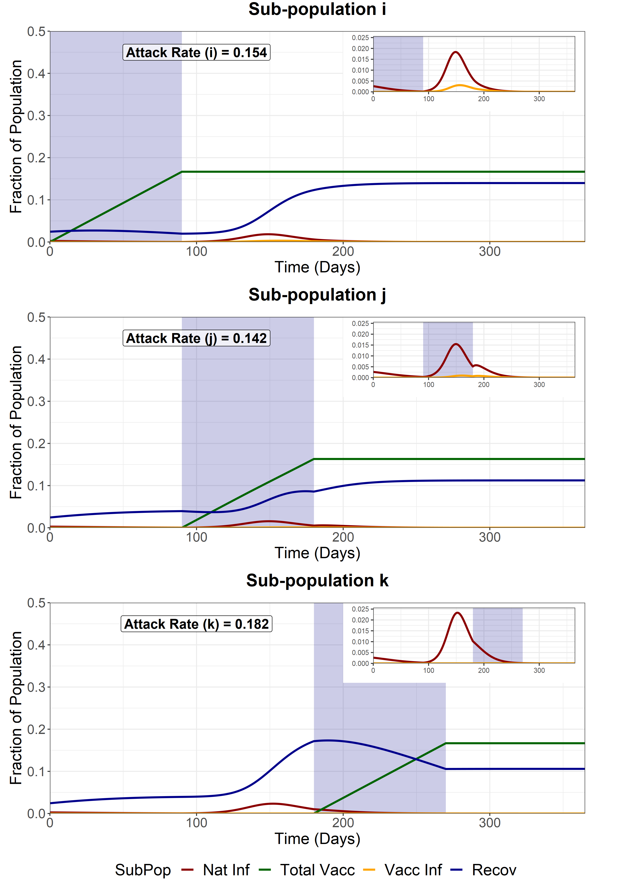
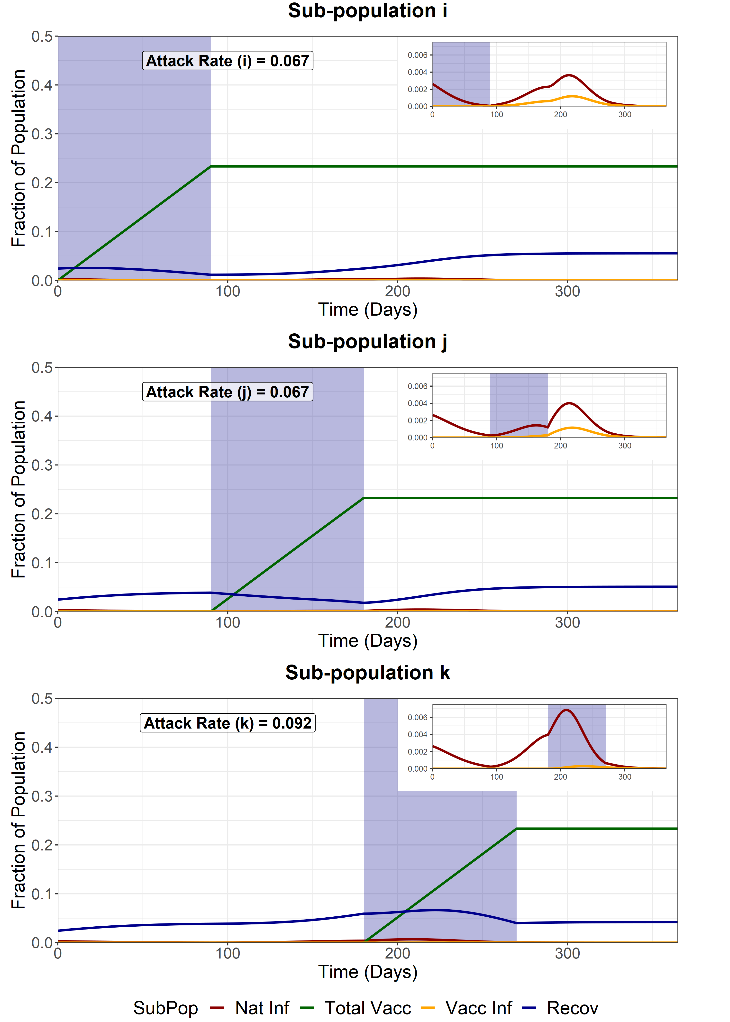

Sequential Vaccination
We model sequential vaccination of 3 sub-populations. Each vaccination schedule lasts 90 days and aims for a variable coverage of the available susceptibles, infecteds and recovereds at the beginning of the simulation. After vaccination of each subpopulation, the sub-population is released from NPIs, with the R increasing from 1 to 4.2. WAIFW matrix changes are the same as the baseline scenarios.
Vaccine Coverage = 50%
Vaccine Coverage = 70%
Vaccine Coverage = 90%
Attack Rate for fully susceptible individuals in sub-group i = 0.131
Attack Rate for fully susceptible individuals in sub-group i = 0.053
Attack Rate for fully susceptible individuals in sub-group i = 0.0084

Slide 48



Full Release - First Group (i)
We model a full release of the entire population (i, j and k) after the vaccination of the first sub-population (i). This increases the R of the entire population from 1 to 4.2. WAIFW matrix changes are the same as the baseline scenarios.
Vaccine Coverage = 50%
Vaccine Coverage = 70%
Vaccine Coverage = 90%
Attack Rate for fully susceptible individuals in sub-group i = 0.147
Attack Rate for fully susceptible individuals in sub-group i = 0.088
Attack Rate for fully susceptible individuals in sub-group i = 0.032

Slide 49



Full Release - Second Group (j)
We model a full release of the entire population (i, j and k) after the vaccination of the second sub-population (j). This increases the R of the entire population from 1 to 4.2. WAIFW matrix changes are the same as the baseline scenarios.
Vaccine Coverage = 50%
Vaccine Coverage = 70%
Vaccine Coverage = 90%
Attack Rate for fully susceptible individuals in sub-group i = 0.128
Attack Rate for fully susceptible individuals in sub-group i = 0.0186
Attack Rate for fully susceptible individuals in sub-group i = 0.008

Slide 50



Full Release - Third Group (k)
We model a full release of the entire population (i, j and k) after the vaccination of the last sub-population (k). This increases the R of the entire population from 1 to 4.2. WAIFW matrix changes are the same as the baseline scenarios.
Vaccine Coverage = 50%
Vaccine Coverage = 70%
Vaccine Coverage = 90%
Attack Rate for fully susceptible individuals in sub-group i = 0.0120
Attack Rate for fully susceptible individuals in sub-group i = 0.0094
Attack Rate for fully susceptible individuals in sub-group i = 0.008

Slide 51



Vaccine Coverage = 50%
Vaccine Coverage = 70%
Vaccine Coverage = 90%
Sequential Vaccination
Attack Rate (i) – 0.154
Attack Rate (j) – 0.142
Attack Rate (k) – 0.182
Attack Rate for fully susceptibles in i - 0.131
Full Release after i vacc
Attack Rate (i) – 0.182
Attack Rate (j) – 0.256
Attack Rate (k) – 0.286
Attack Rate for fully susceptibles in i - 0.147
Full Release after j vacc
Attack Rate (i) – 0.151
Attack Rate (j) – 0.153
Attack Rate (k) – 0.181
Attack Rate for fully susceptibles in i - 0.128
Full Release after k vacc
Attack Rate (i) – 0.012
Attack Rate (j) – 0.014
Attack Rate (k) – 0.015
Attack Rate for fully susceptibles in i - 0.0120
Sequential Vaccination
Attack Rate (i) – 0.067
Attack Rate (j) – 0.067
Attack Rate (k) – 0.092
Attack Rate for fully susceptibles in i - 0.053
Full Release after i vacc
Attack Rate (i) – 0.13
Attack Rate (j) – 0.223
Attack Rate (k) – 0.274
Attack Rate for fully susceptibles in i - 0.088
Full Release after j vacc
Attack Rate (i) – 0.021
Attack Rate (j) – 0.024
Attack Rate (k) – 0.024
Attack Rate for fully susceptibles in i - 0.0186
Full Release after k vacc
Attack Rate (i) – 0.01
Attack Rate (j) – 0.012
Attack Rate (k) – 0.012
Attack Rate for fully susceptibles in i - 0.0094
Sequential Vaccination
Attack Rate (i) – 0.009
Attack Rate (j) – 0.012
Attack Rate (k) – 0.012
Attack Rate for fully susceptibles in i - 0.0084
Full Release after i vacc
Attack Rate (i) – 0.073
Attack Rate (j) – 0.173
Attack Rate (k) – 0.25
Attack Rate for fully susceptibles in i - 0.032
Full Release after j vacc
Attack Rate (i) – 0.008
Attack Rate (j) – 0.011
Attack Rate (k) – 0.011
Attack Rate for fully susceptibles in i - 0.008
Full Release after k vacc
Attack Rate (i) – 0.009
Attack Rate (j) – 0.011
Attack Rate (k) – 0.011
Attack Rate for fully susceptibles in i - 0.008

